Slide 1
Analysis and comparison of Two Interior Permanent motors
Presented by:
Shubham Prajapati
Anirudha Behera

Slide 2
Specification Of Motors
Tesla S Motor
Parameter | Value
Output Power | 225 Kw approx
Torque | 384 Nm
Base speed | 5000 rpm
Magnet | NdFeB
Cooling system | Water Jacket
Drive Voltage | 400 V
Nissan Leaf 2012 Motor
Parameter | Value
Output Power | 80 Kw approx
Torque | 284 Nm
Base speed | 3000 rpm
Magnet | NdFeB
Cooling system | Water Jacket
Drive Voltage | 375 V

Slide 3
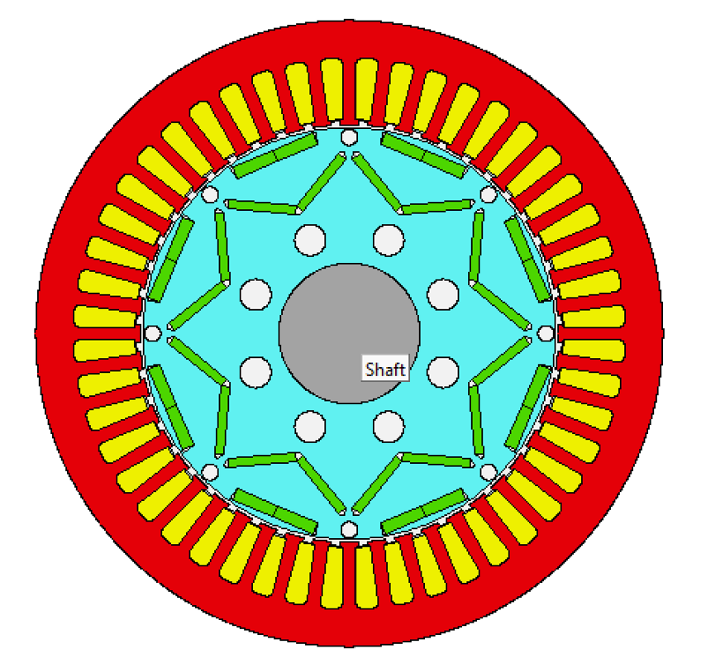
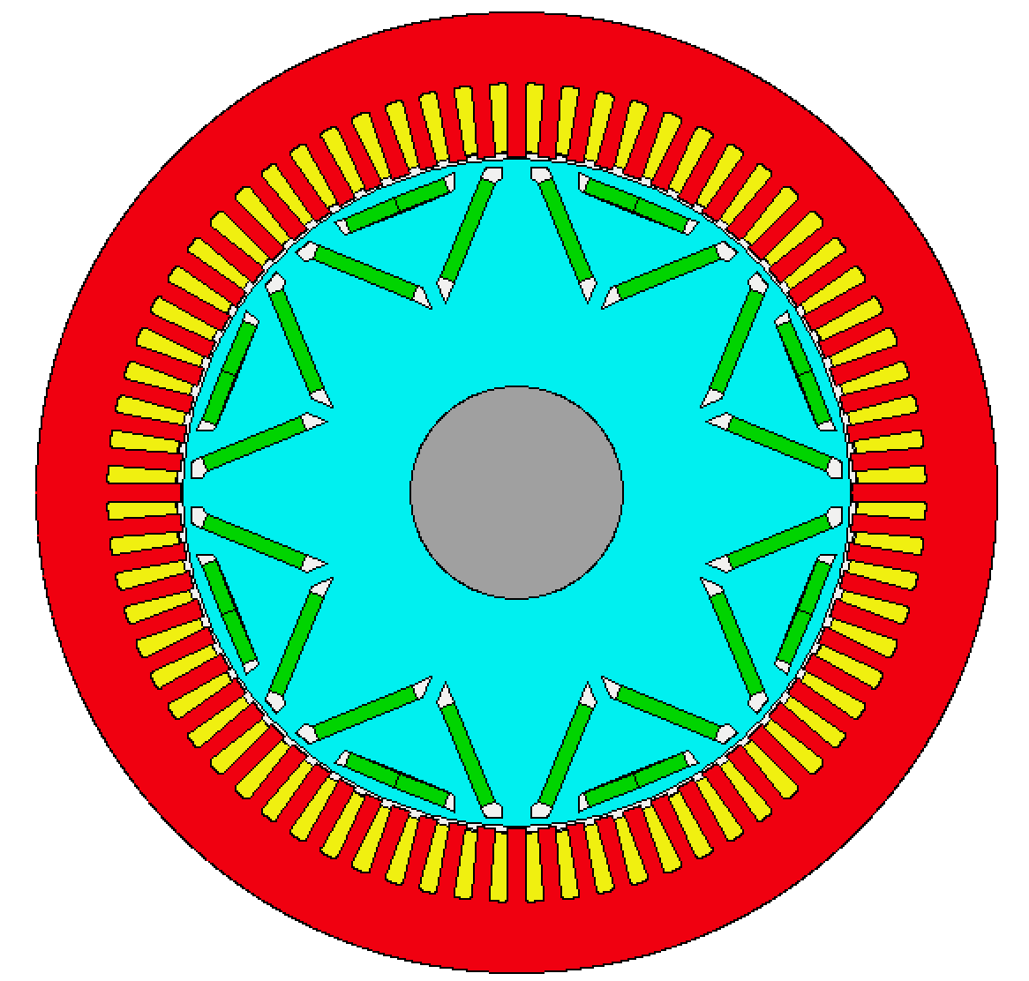
Geometry of Motors

Slide 4
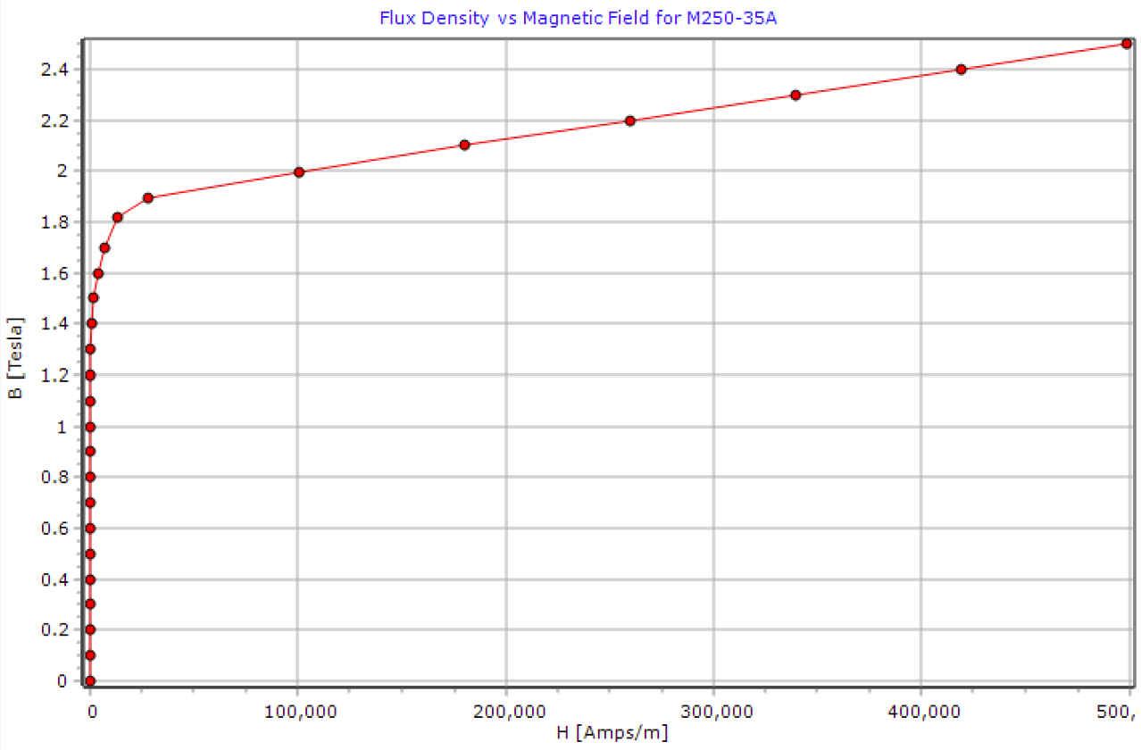
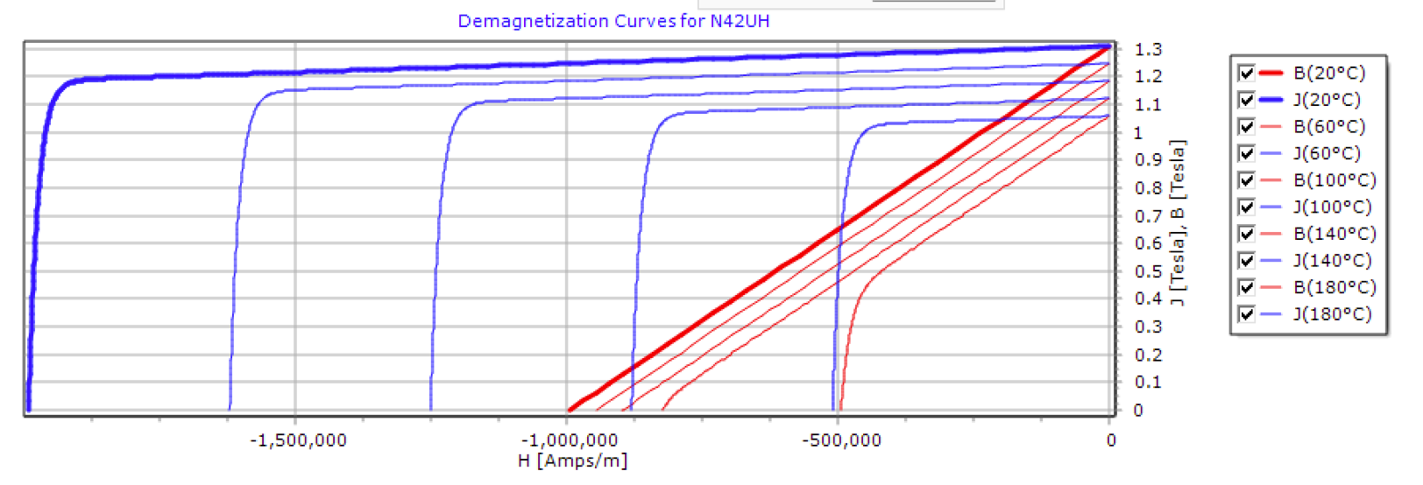
Material Properties
Component | Material
Stator Lamination | M250 -35A
Armature Winding | Copper
Rotor Lamination | M250 -35A
Magnet | N42UH

Slide 5
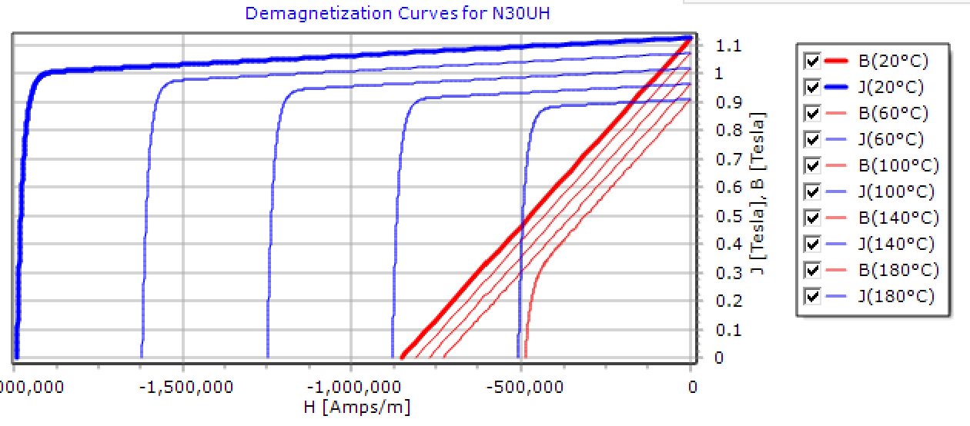
Material properties
Component | Material
Stator Lamination | M250 -35A
Armature Winding | Copper
Rotor Lamination | M250 -35A
Magnet | N30UH

Slide 6
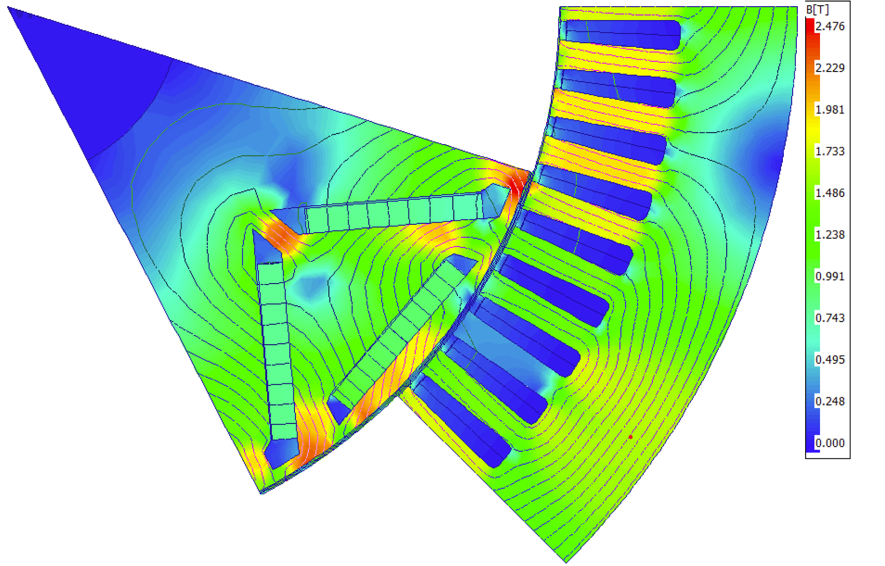
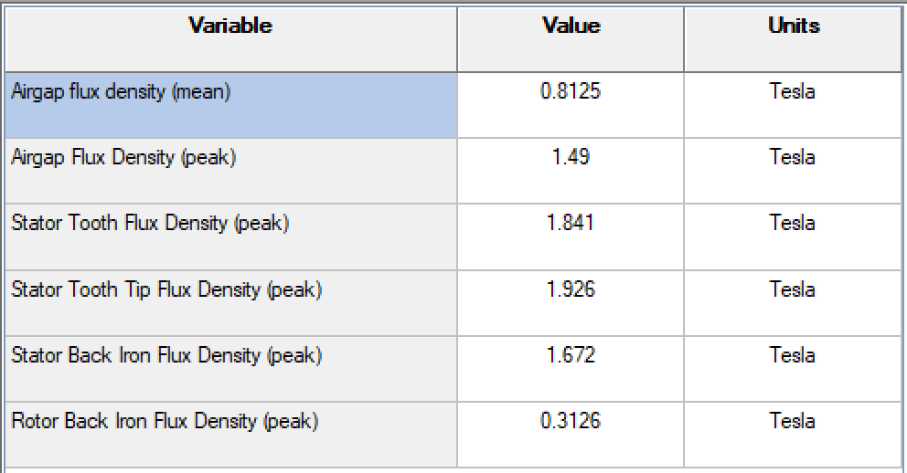
Electromagnetic Analysis Tesla S

Slide 7
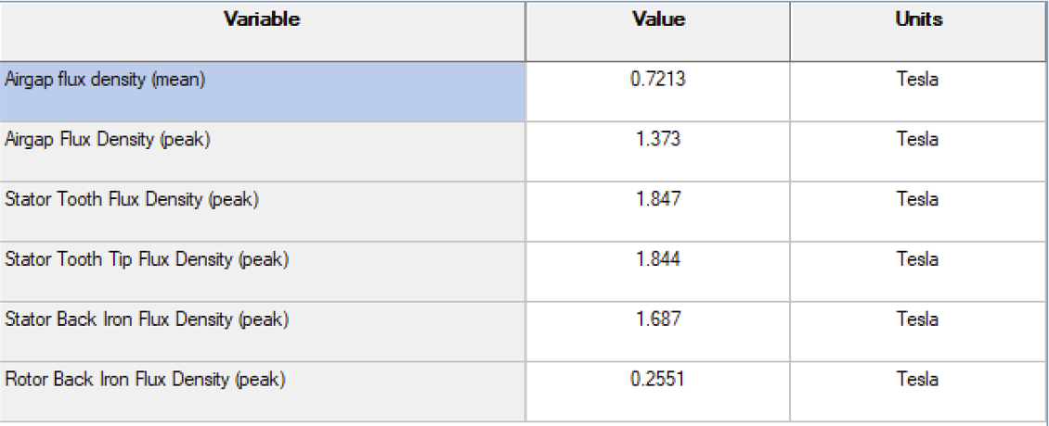
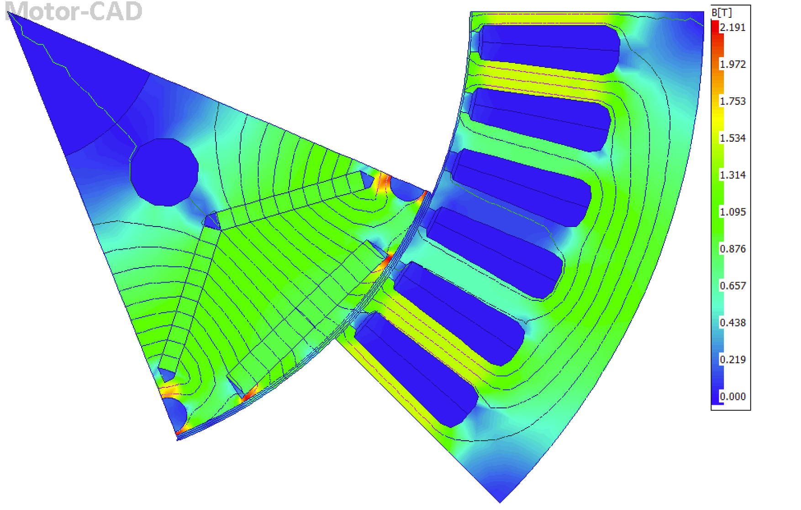
Electromagnetics Analysis Nissan Leaf

Slide 8
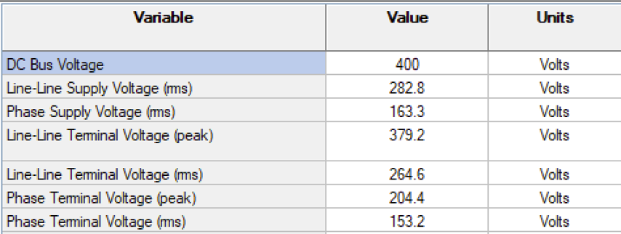
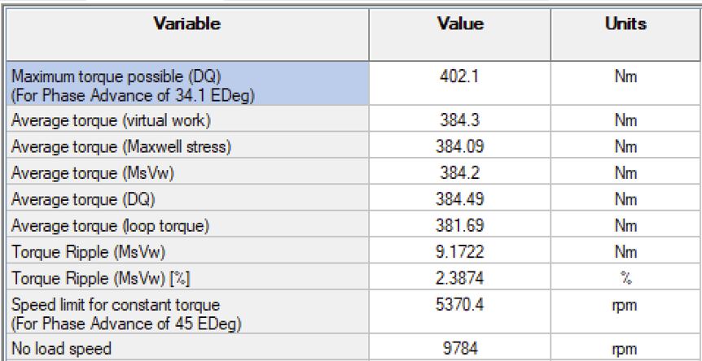
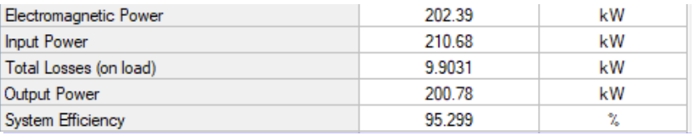
Output data & Losses Tesla S

Slide 9
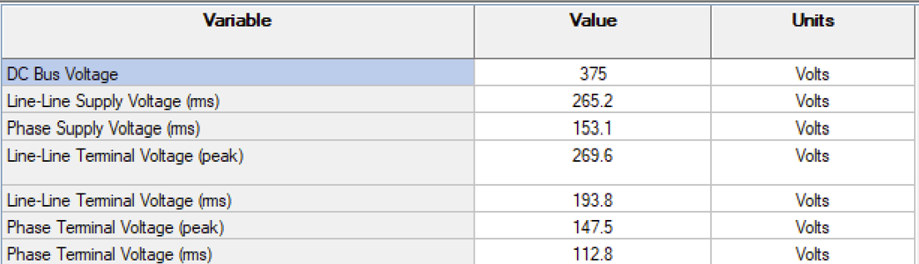
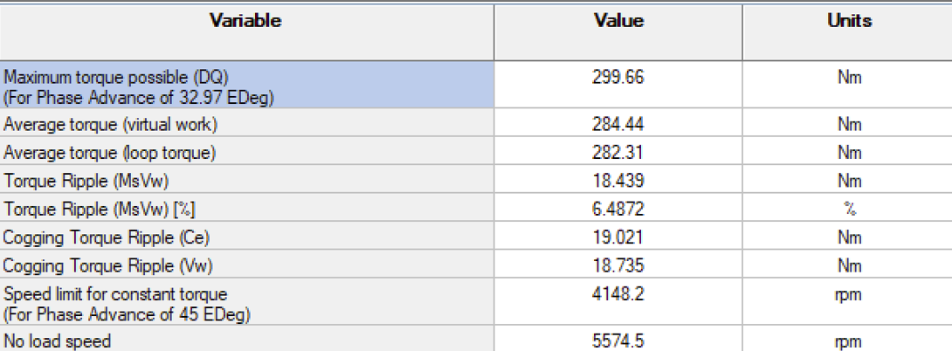
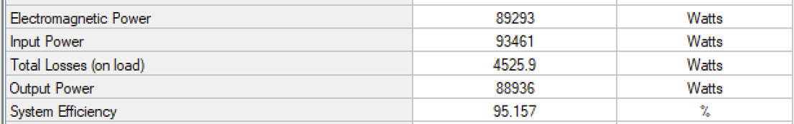
Output data & Losses Nissan Leaf

Slide 10

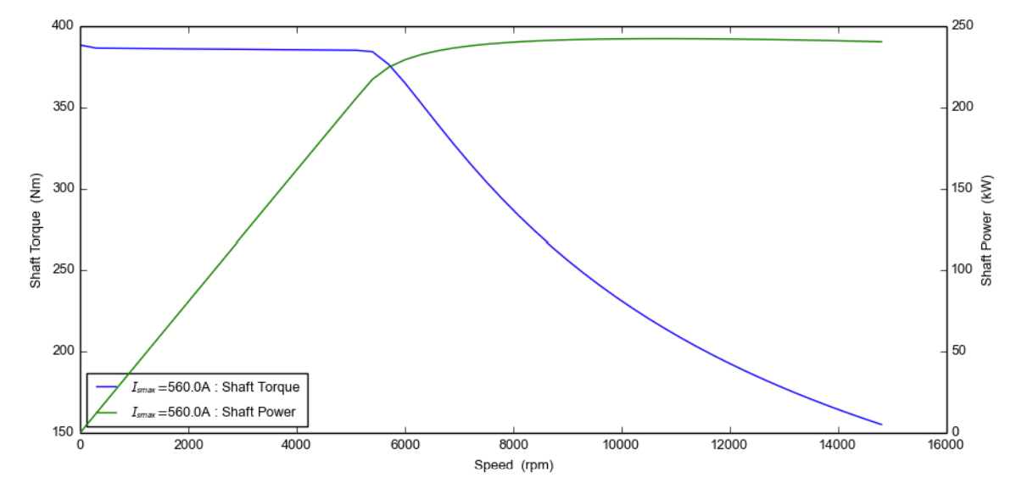
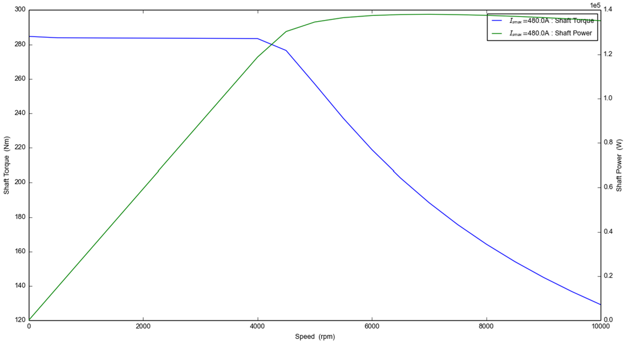
Speed Torque curve of Tesla S
Tesla Model S

Slide 11
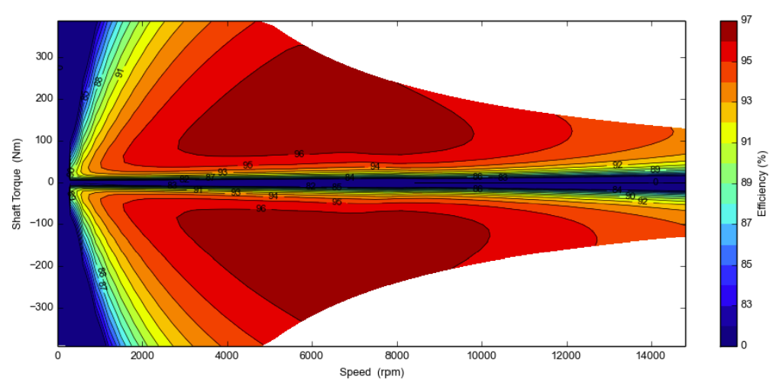
Efficiency Map of Tesla S

Slide 12
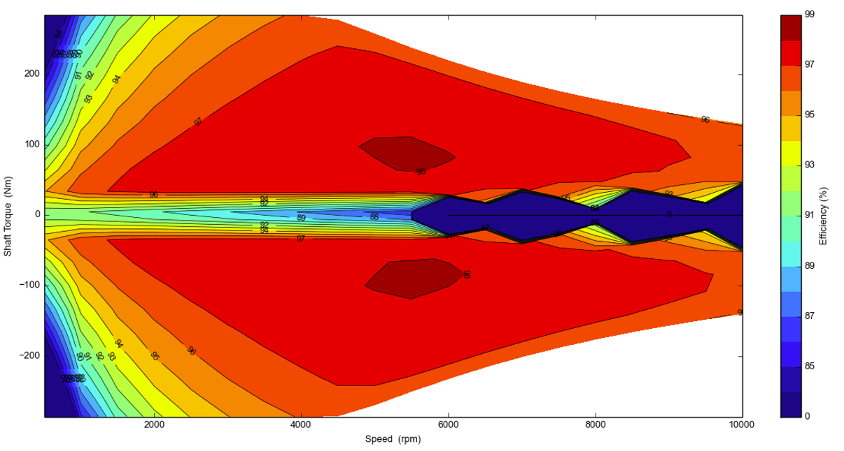
Efficiency Map of Nissan Leaf

Slide 13
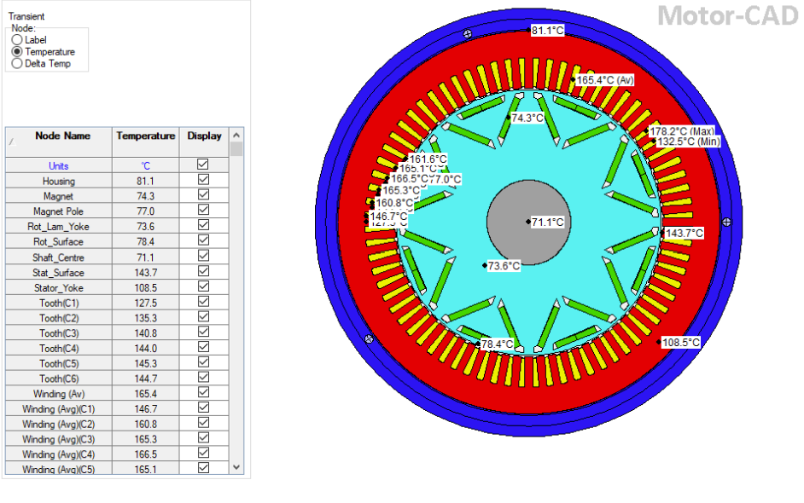
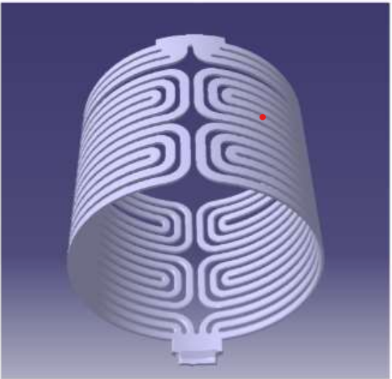
Thermal Analysis of Tesla S
Housing- Water Jet (spiral)
Housing Diameter- 280 mm
Flow type- Turbulent
Fluid volume flow rate- 8 l/min
Calculation type- Transient
Transient period-120 sec
Torque-375 Nm
Speed- 5000 rpm

Slide 14
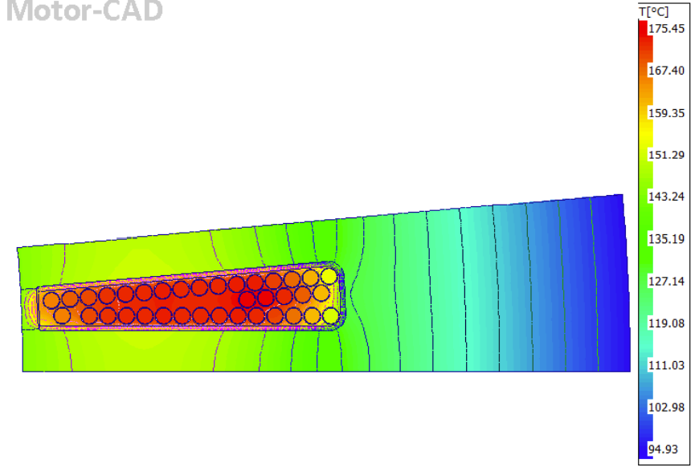
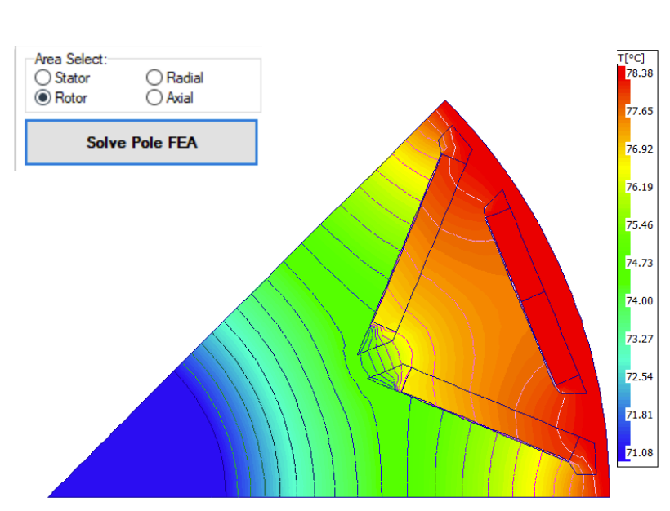
Stator & Rotor 2D FEA

Slide 15
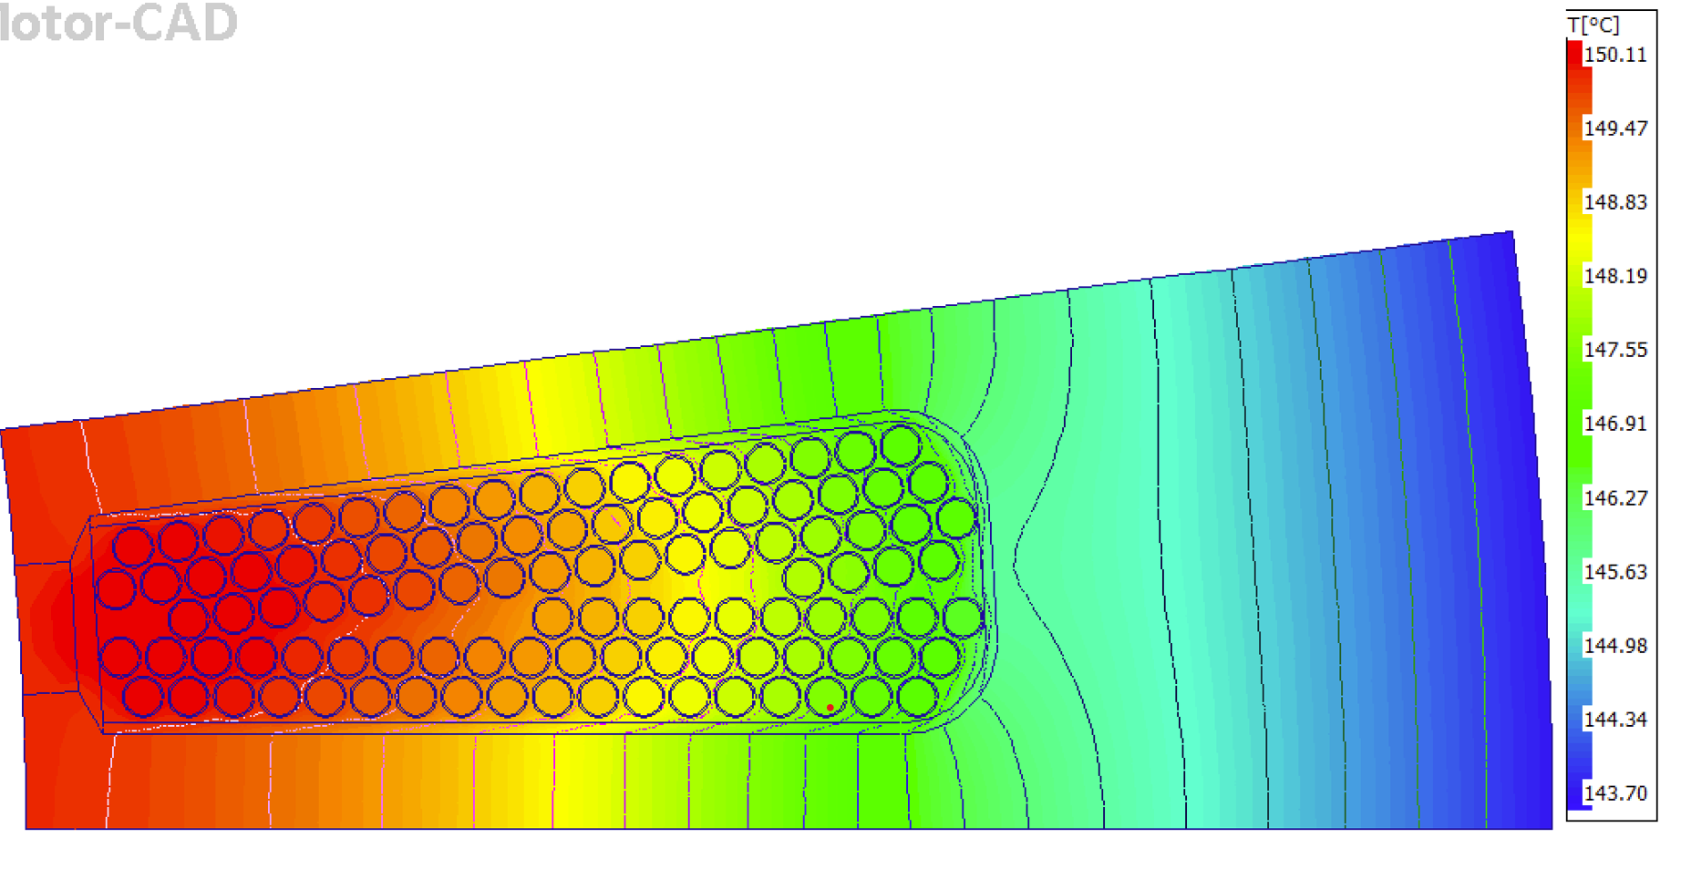
Stator Slot 2D FEA

Slide 16
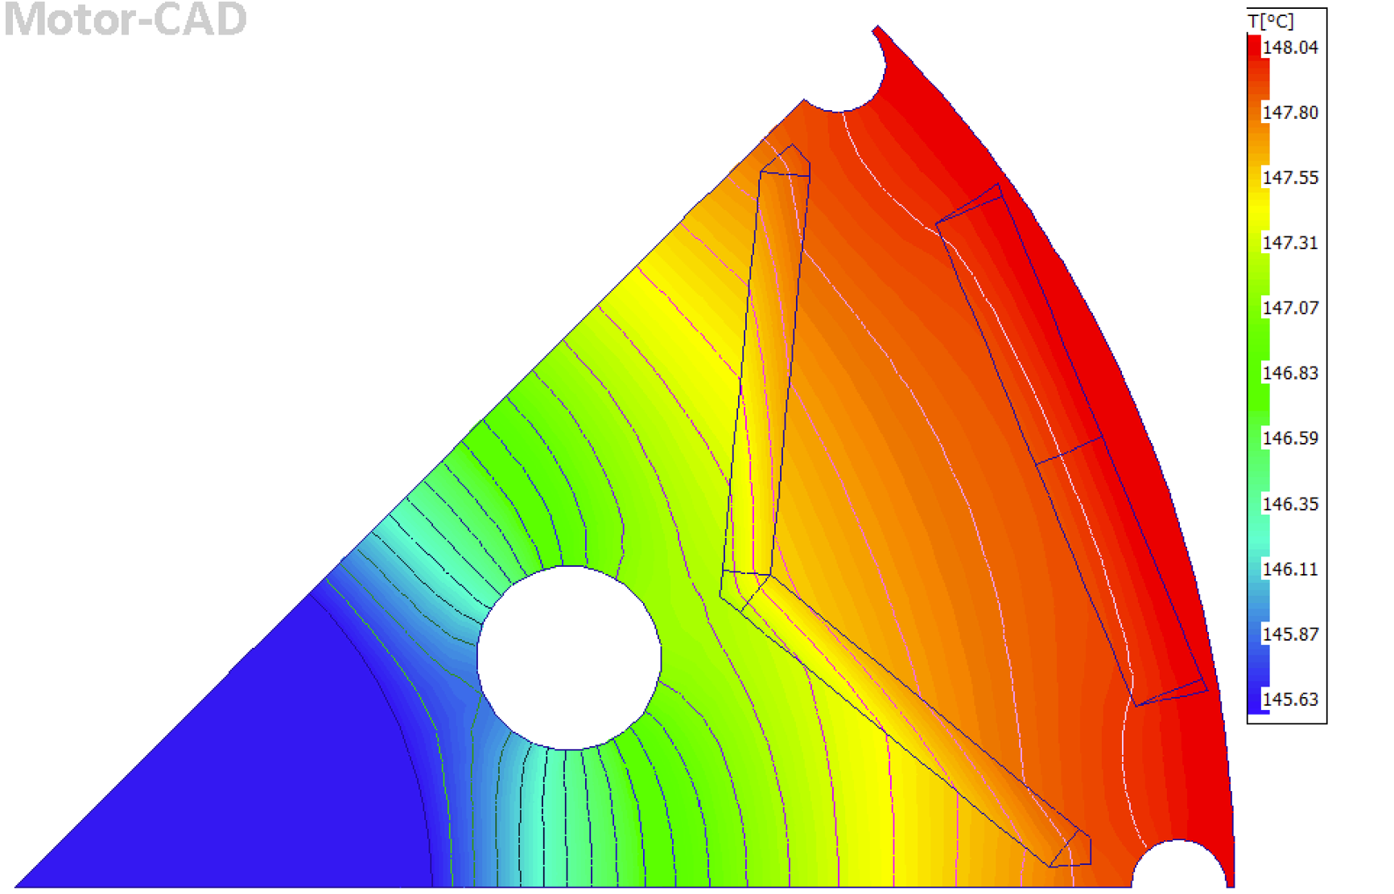
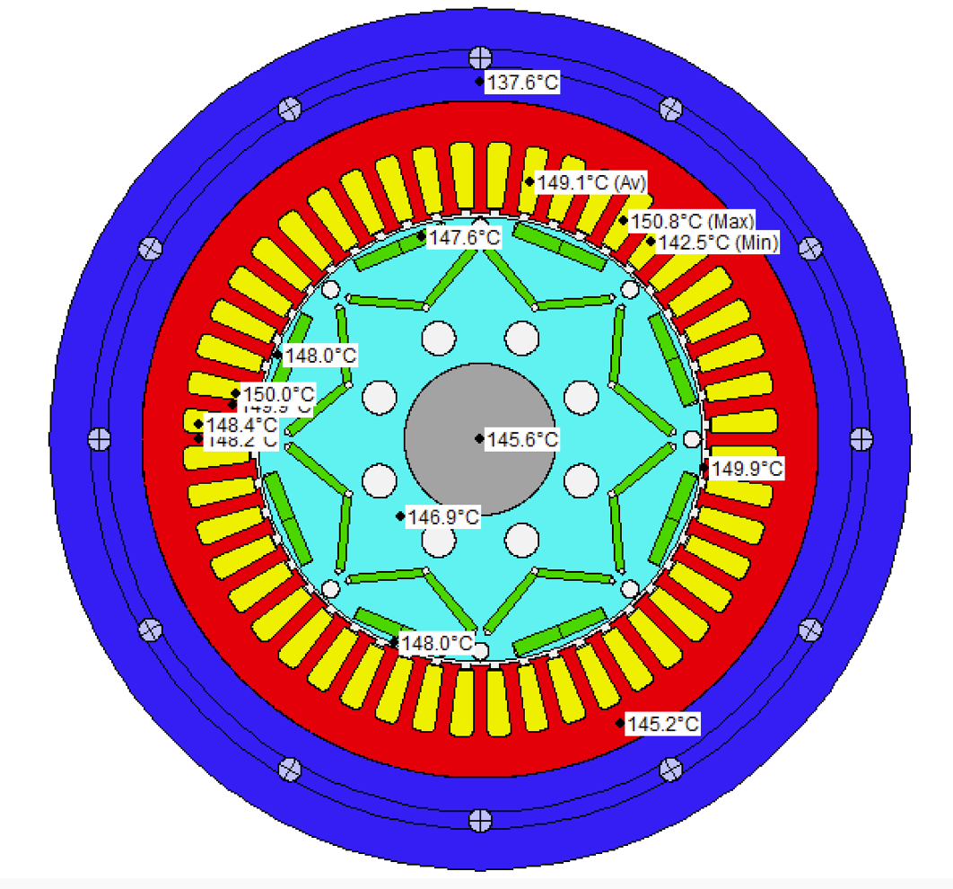
Thermal Analysis of Nissan Leaf

Slide 17
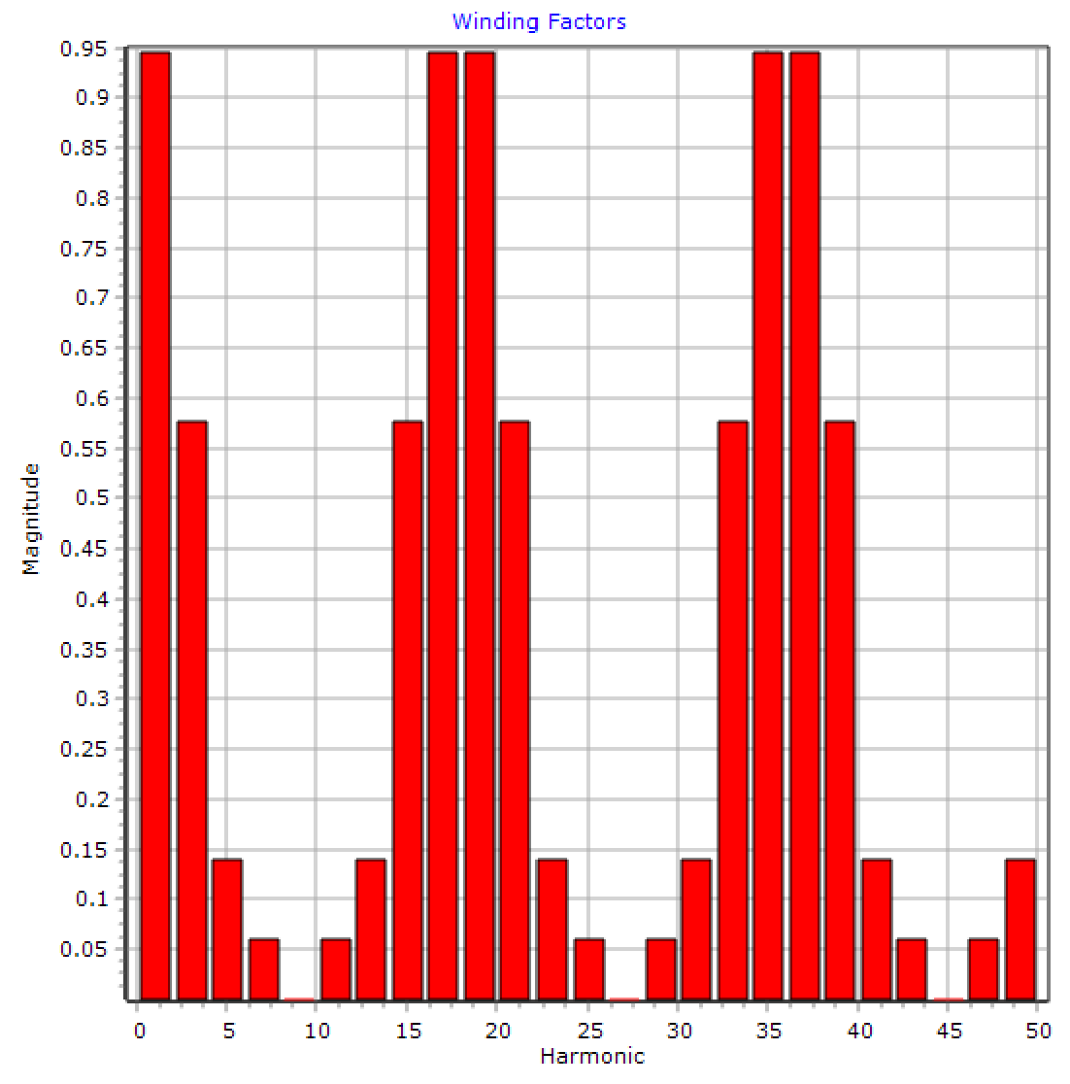
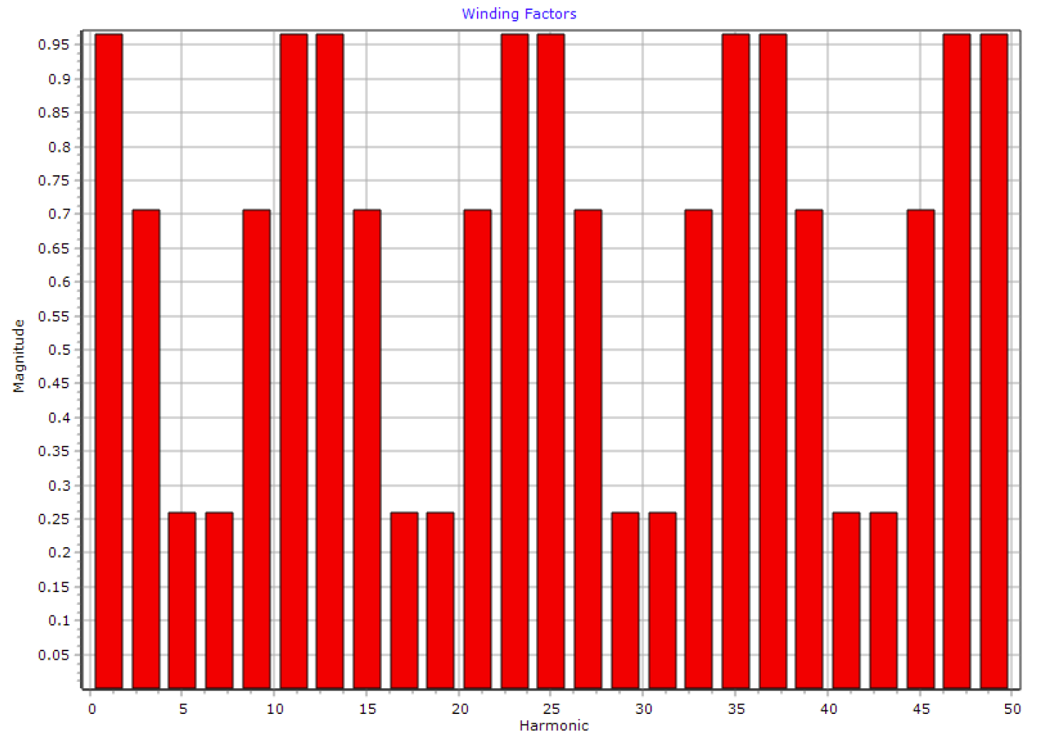
Winding Factors & Harmonics
Tesla Model S

Slide 18
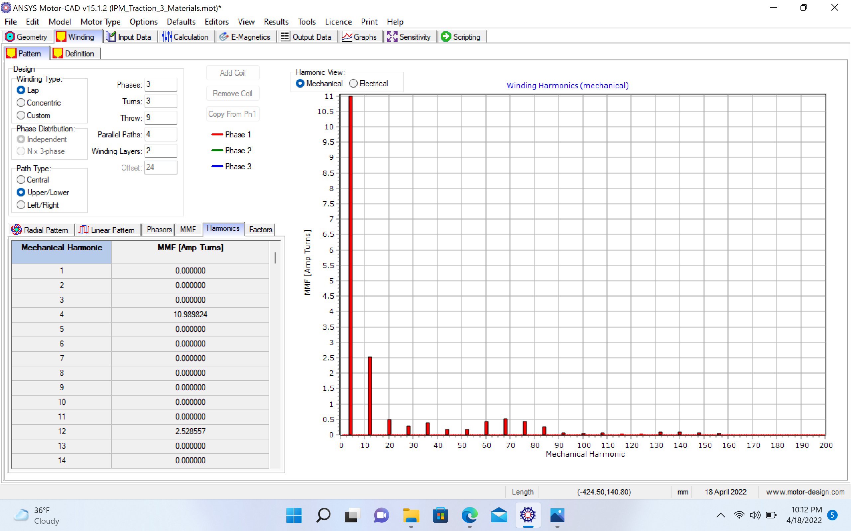
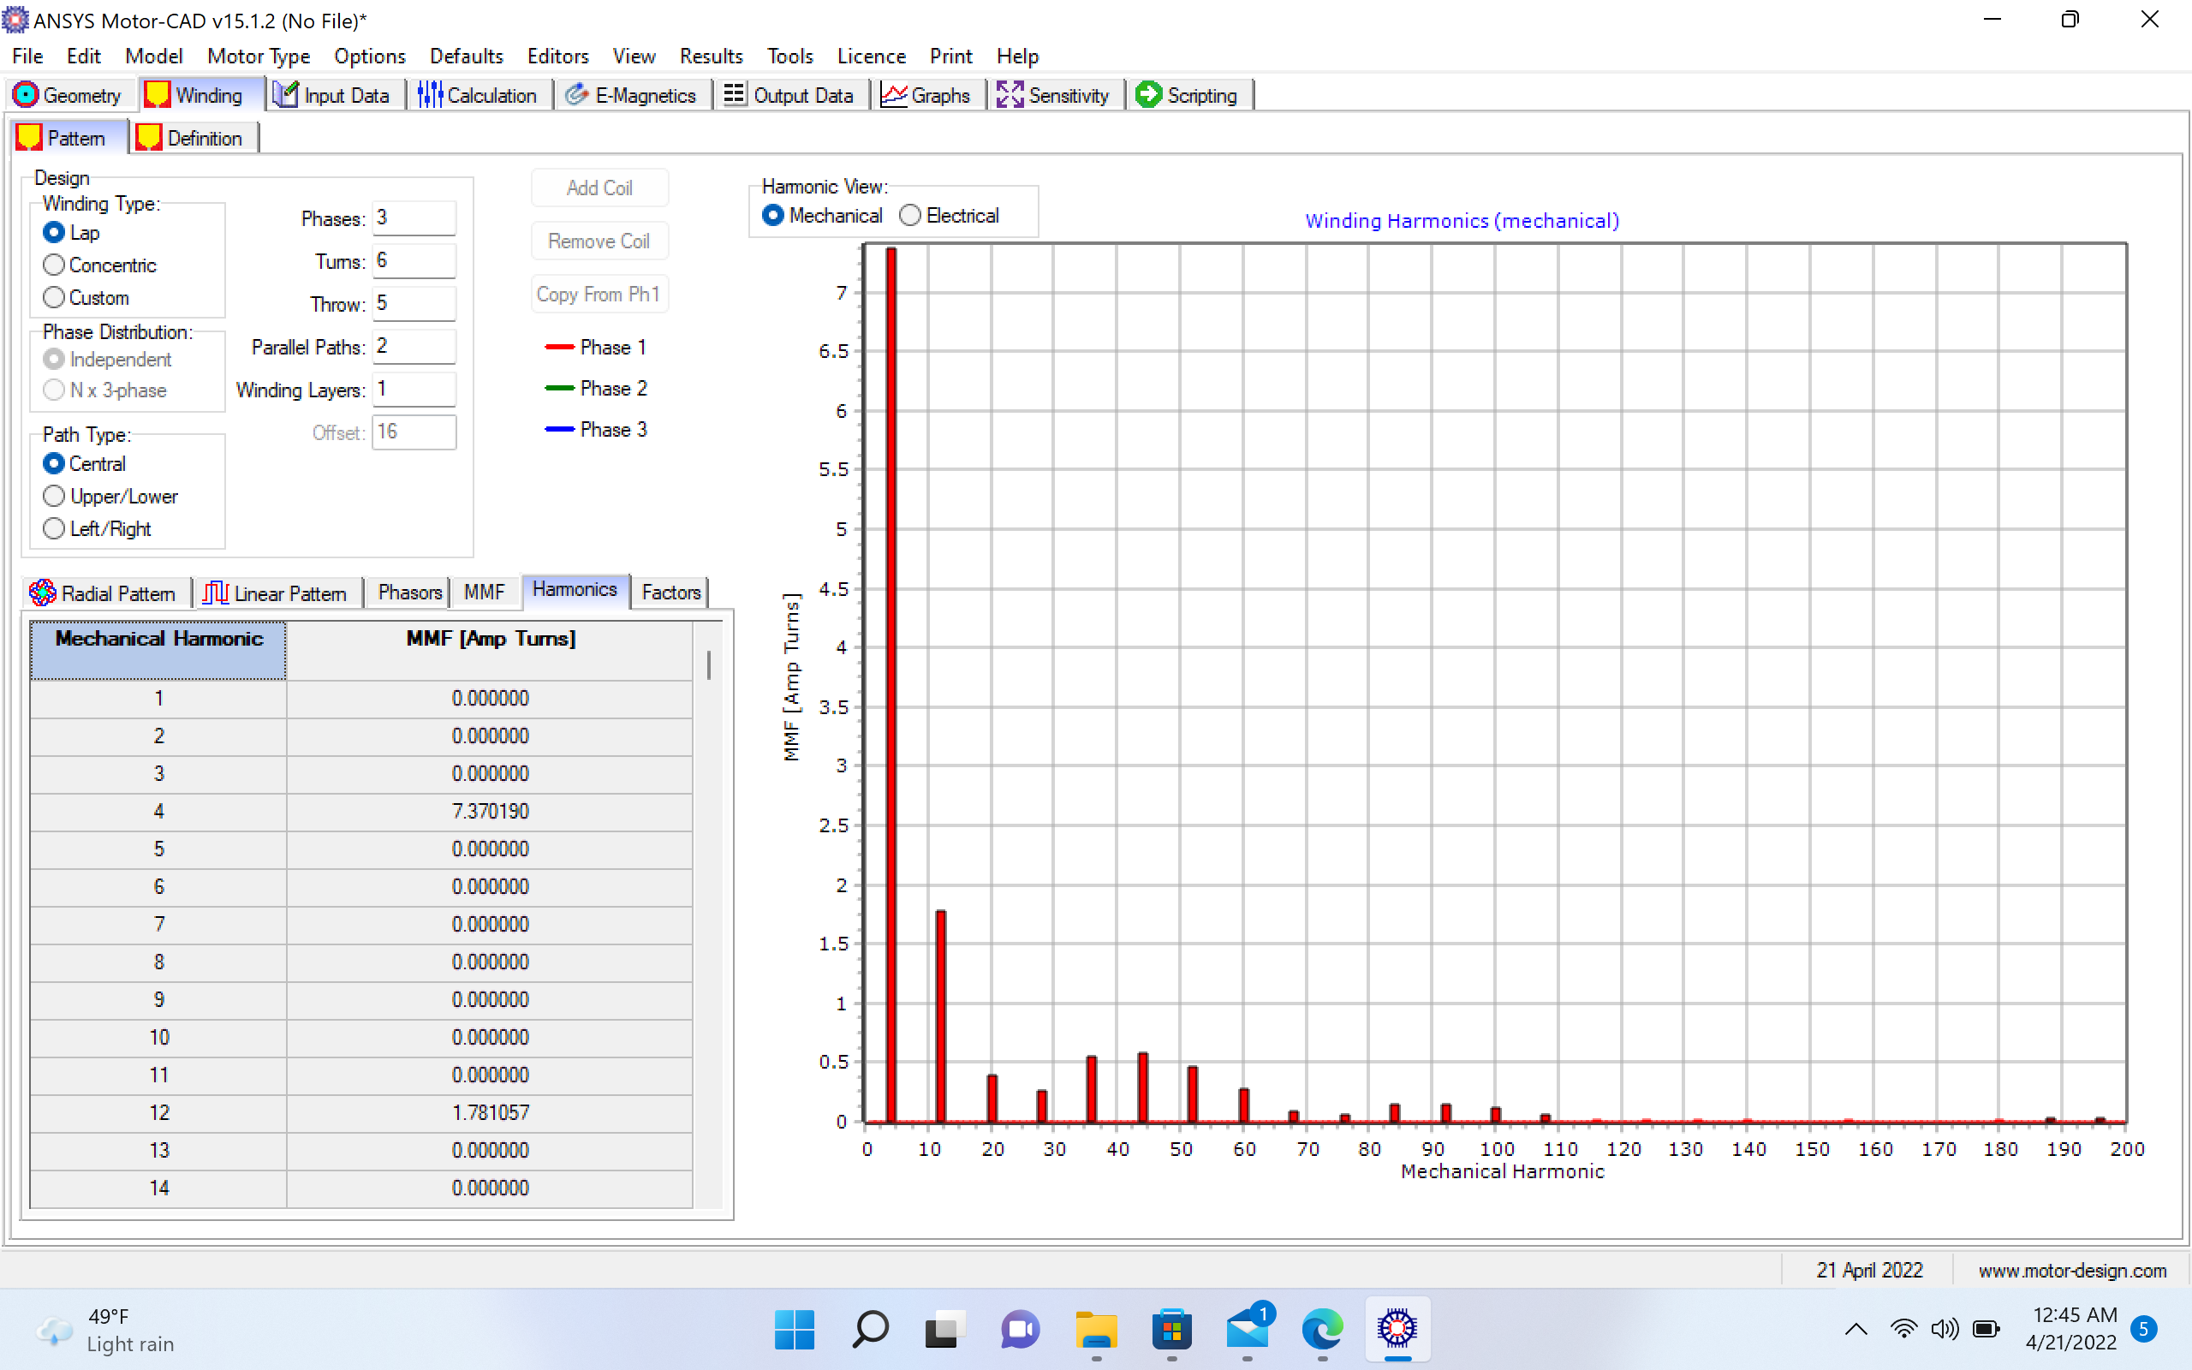
Winding Factor & Harmonics
Tesla Model S

Slide 19
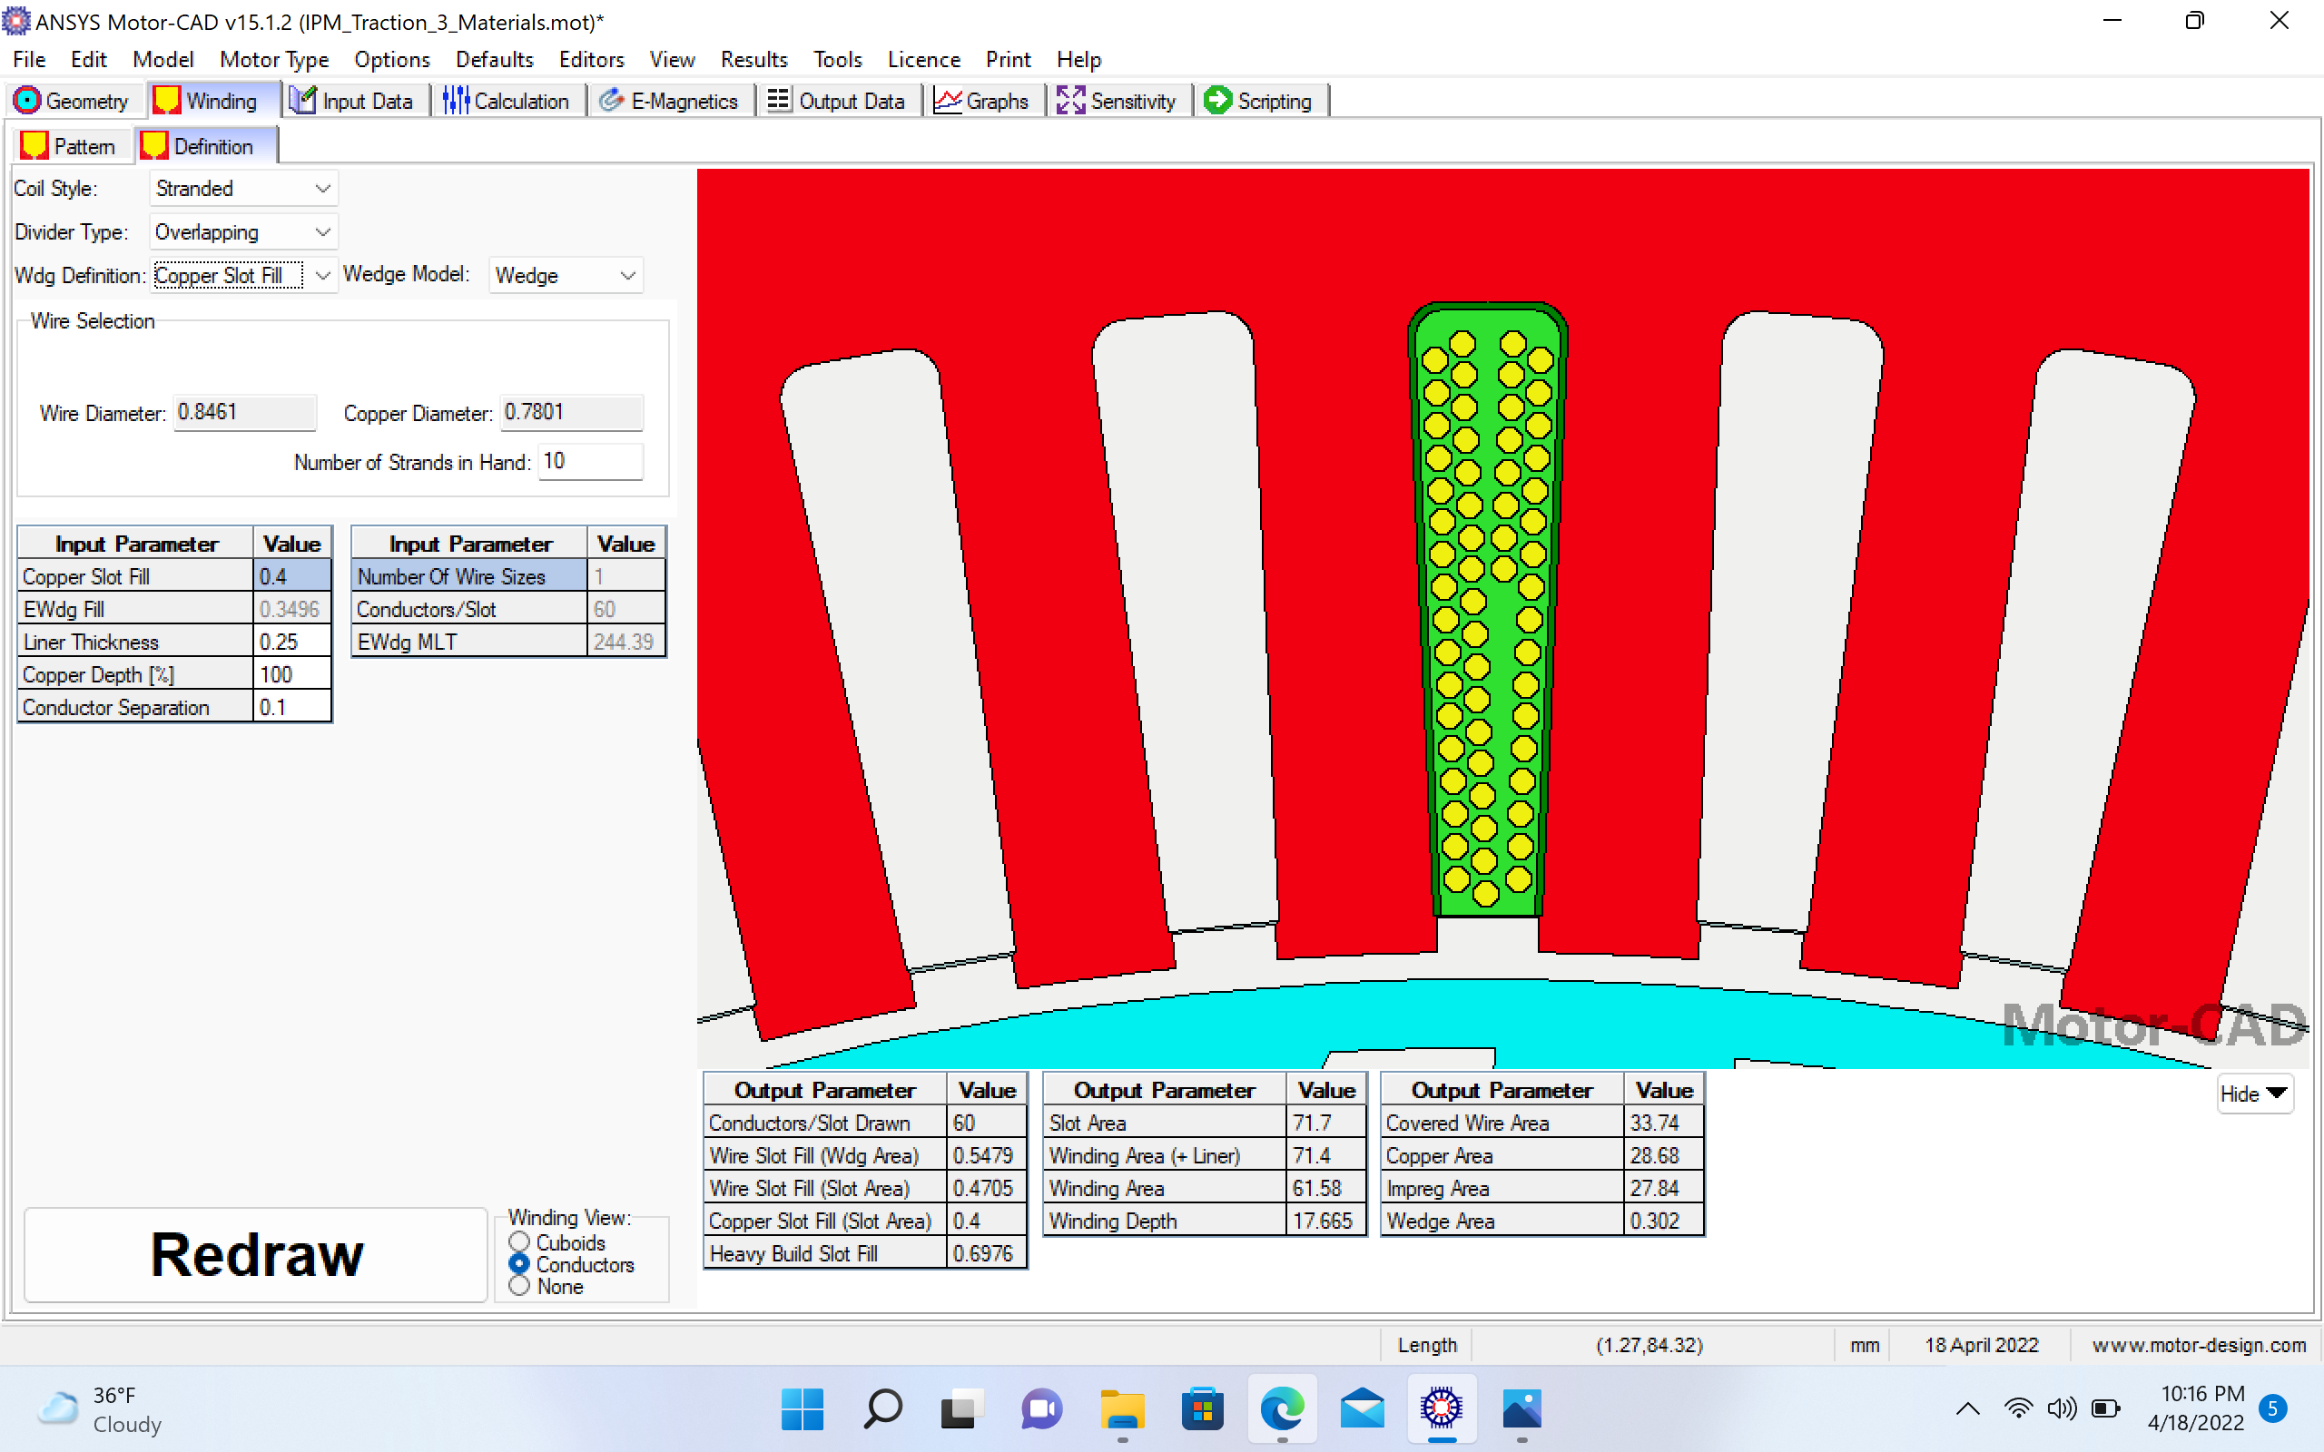
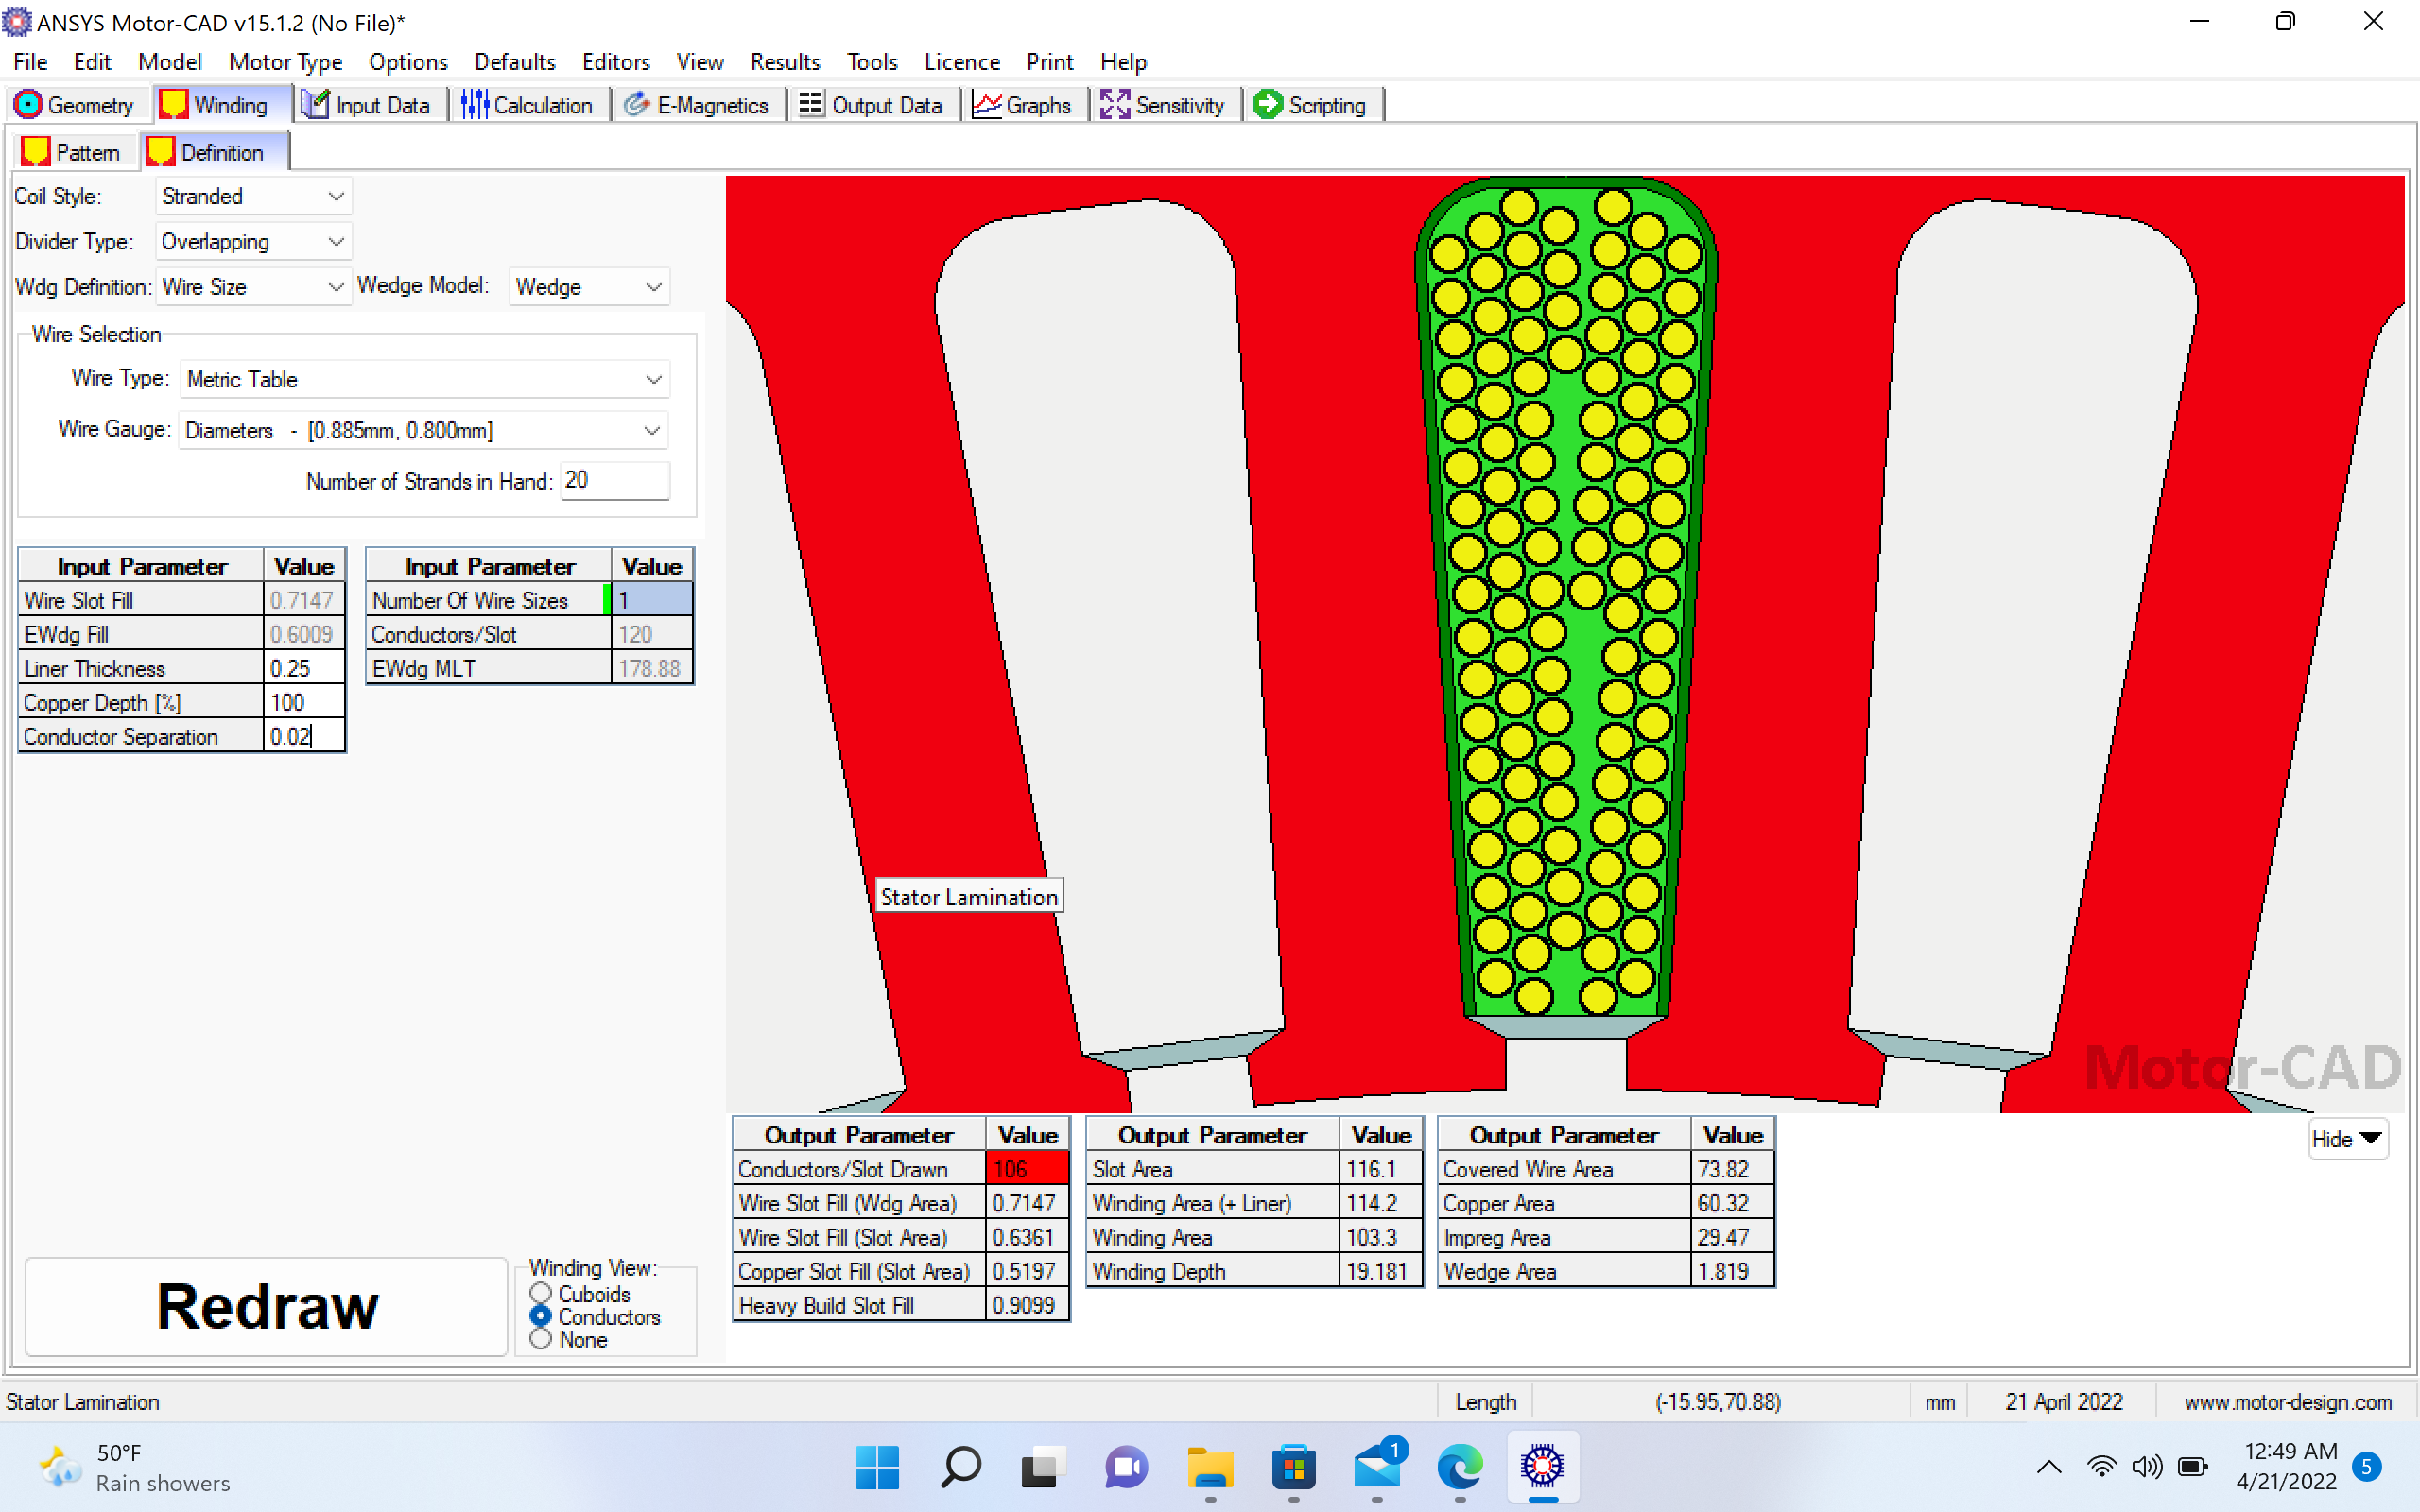
Stator Lamination
Tesla Model S

Slide 20
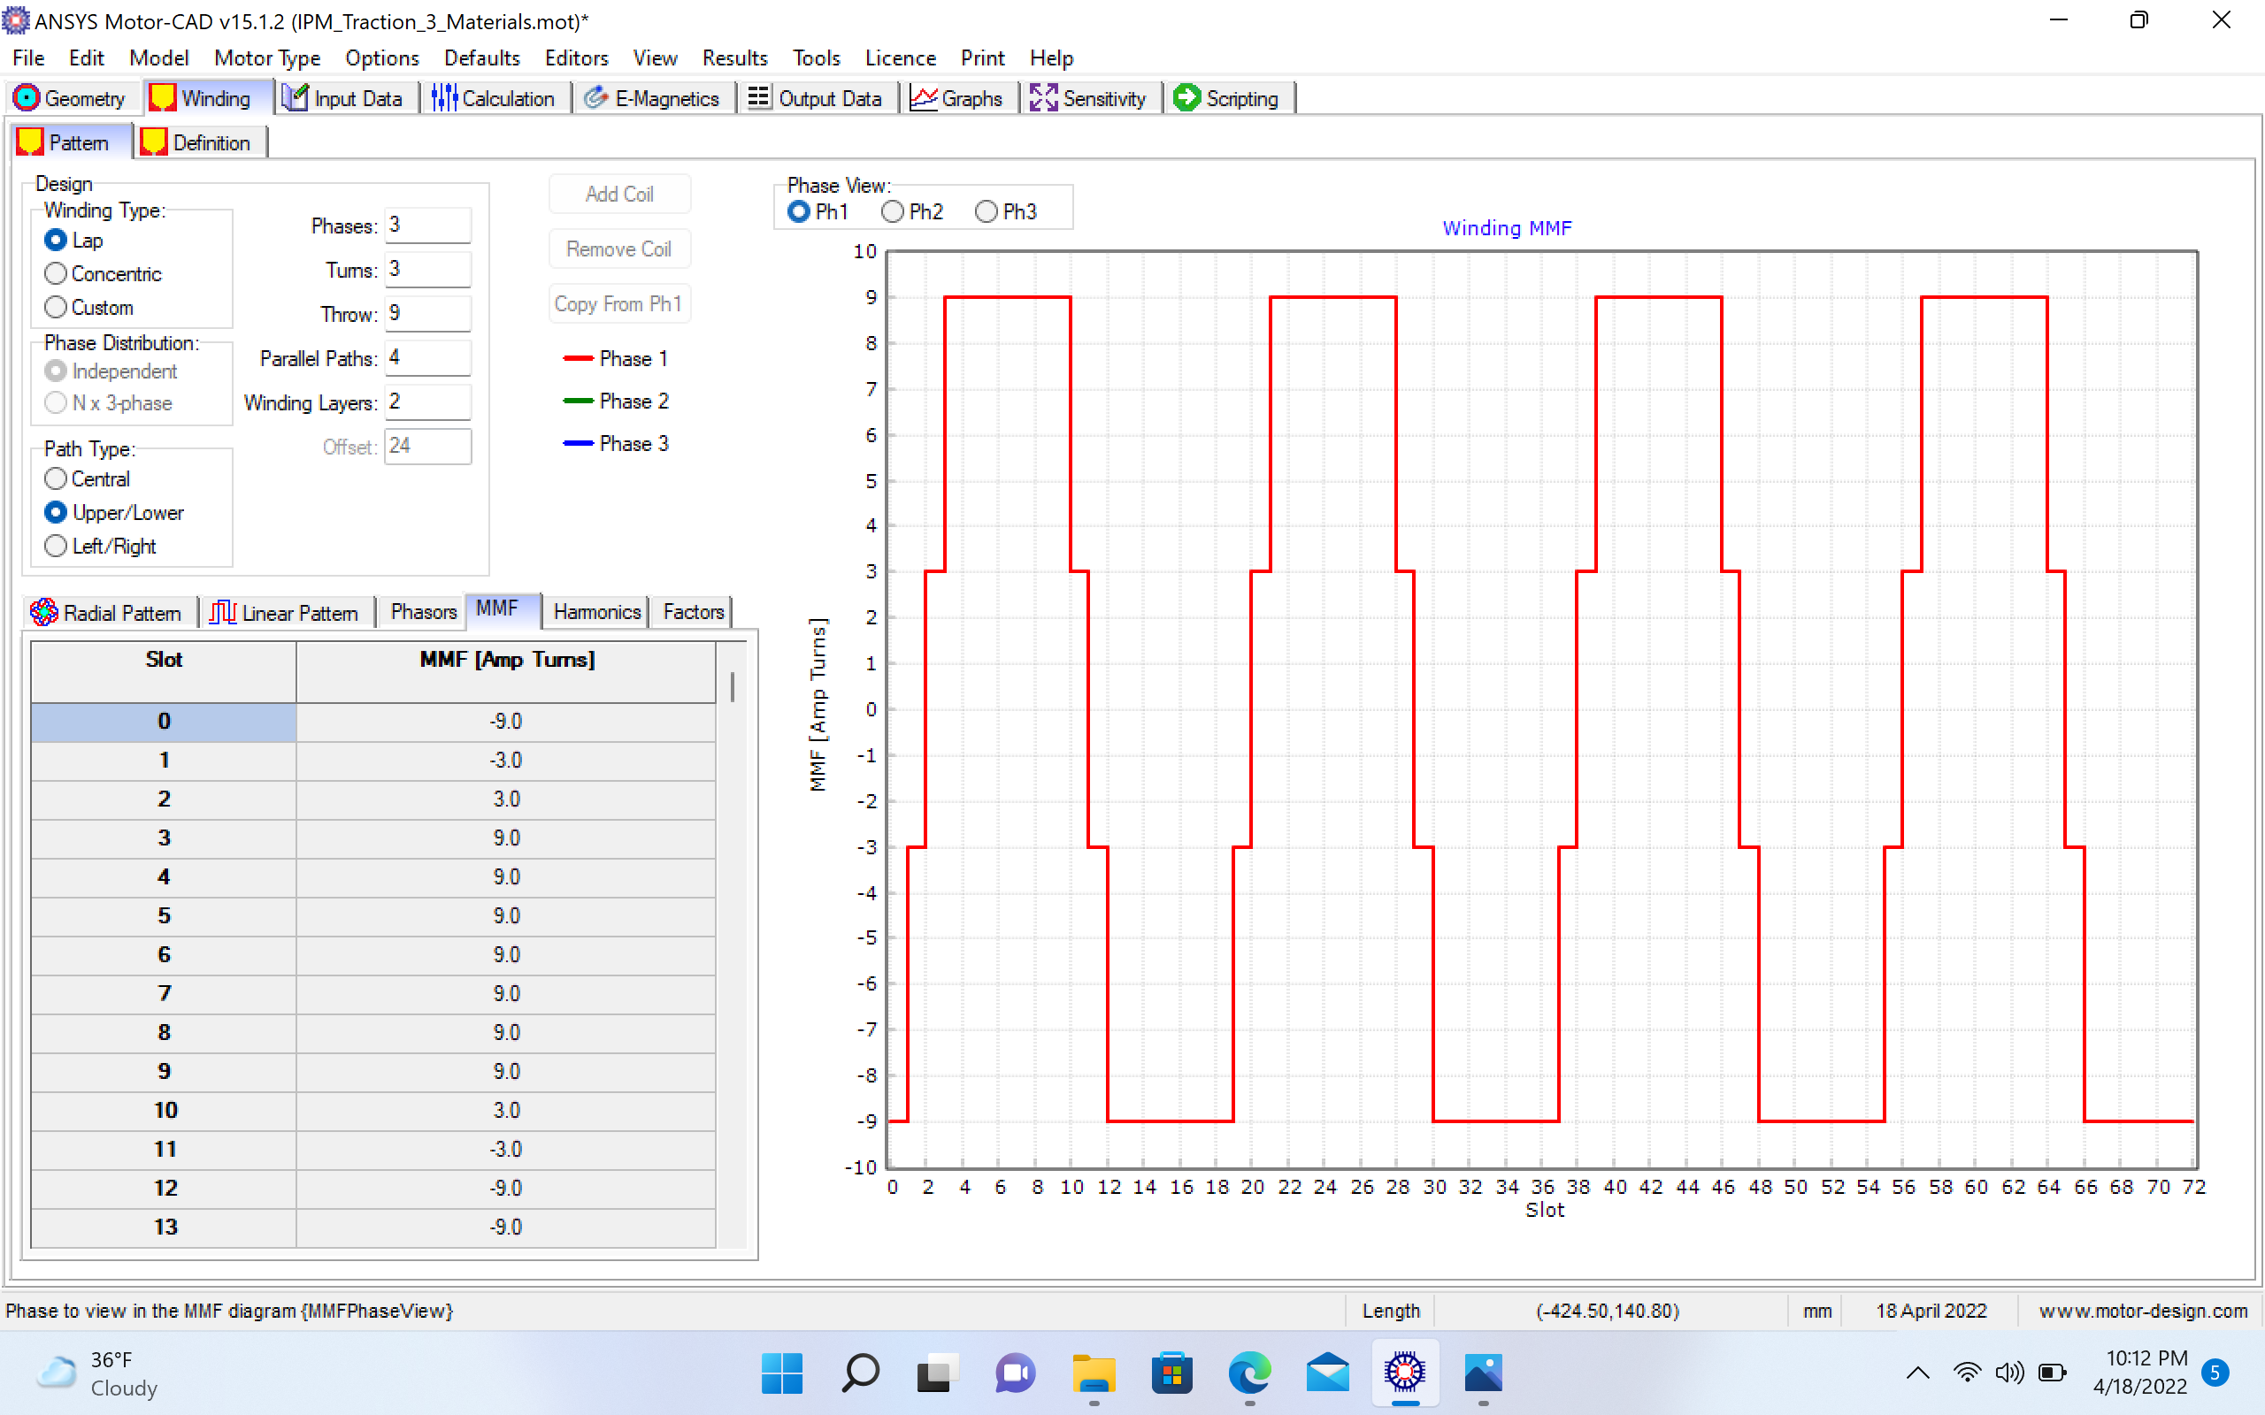
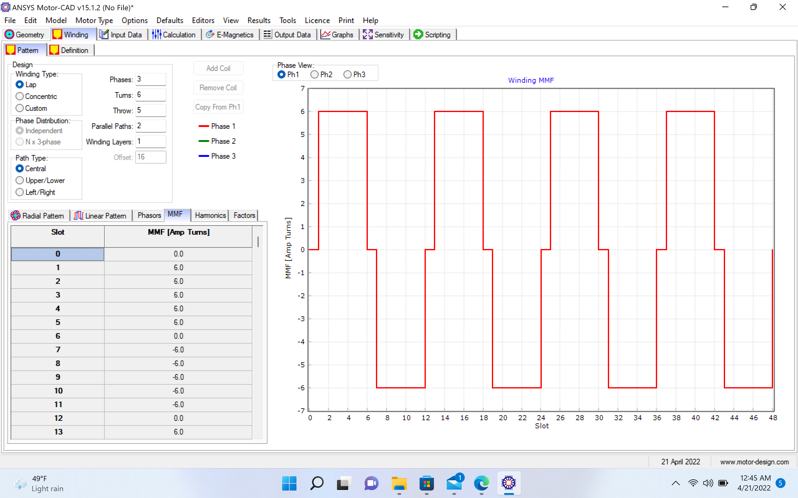
winding MMF
Tesla Model S

Slide 21
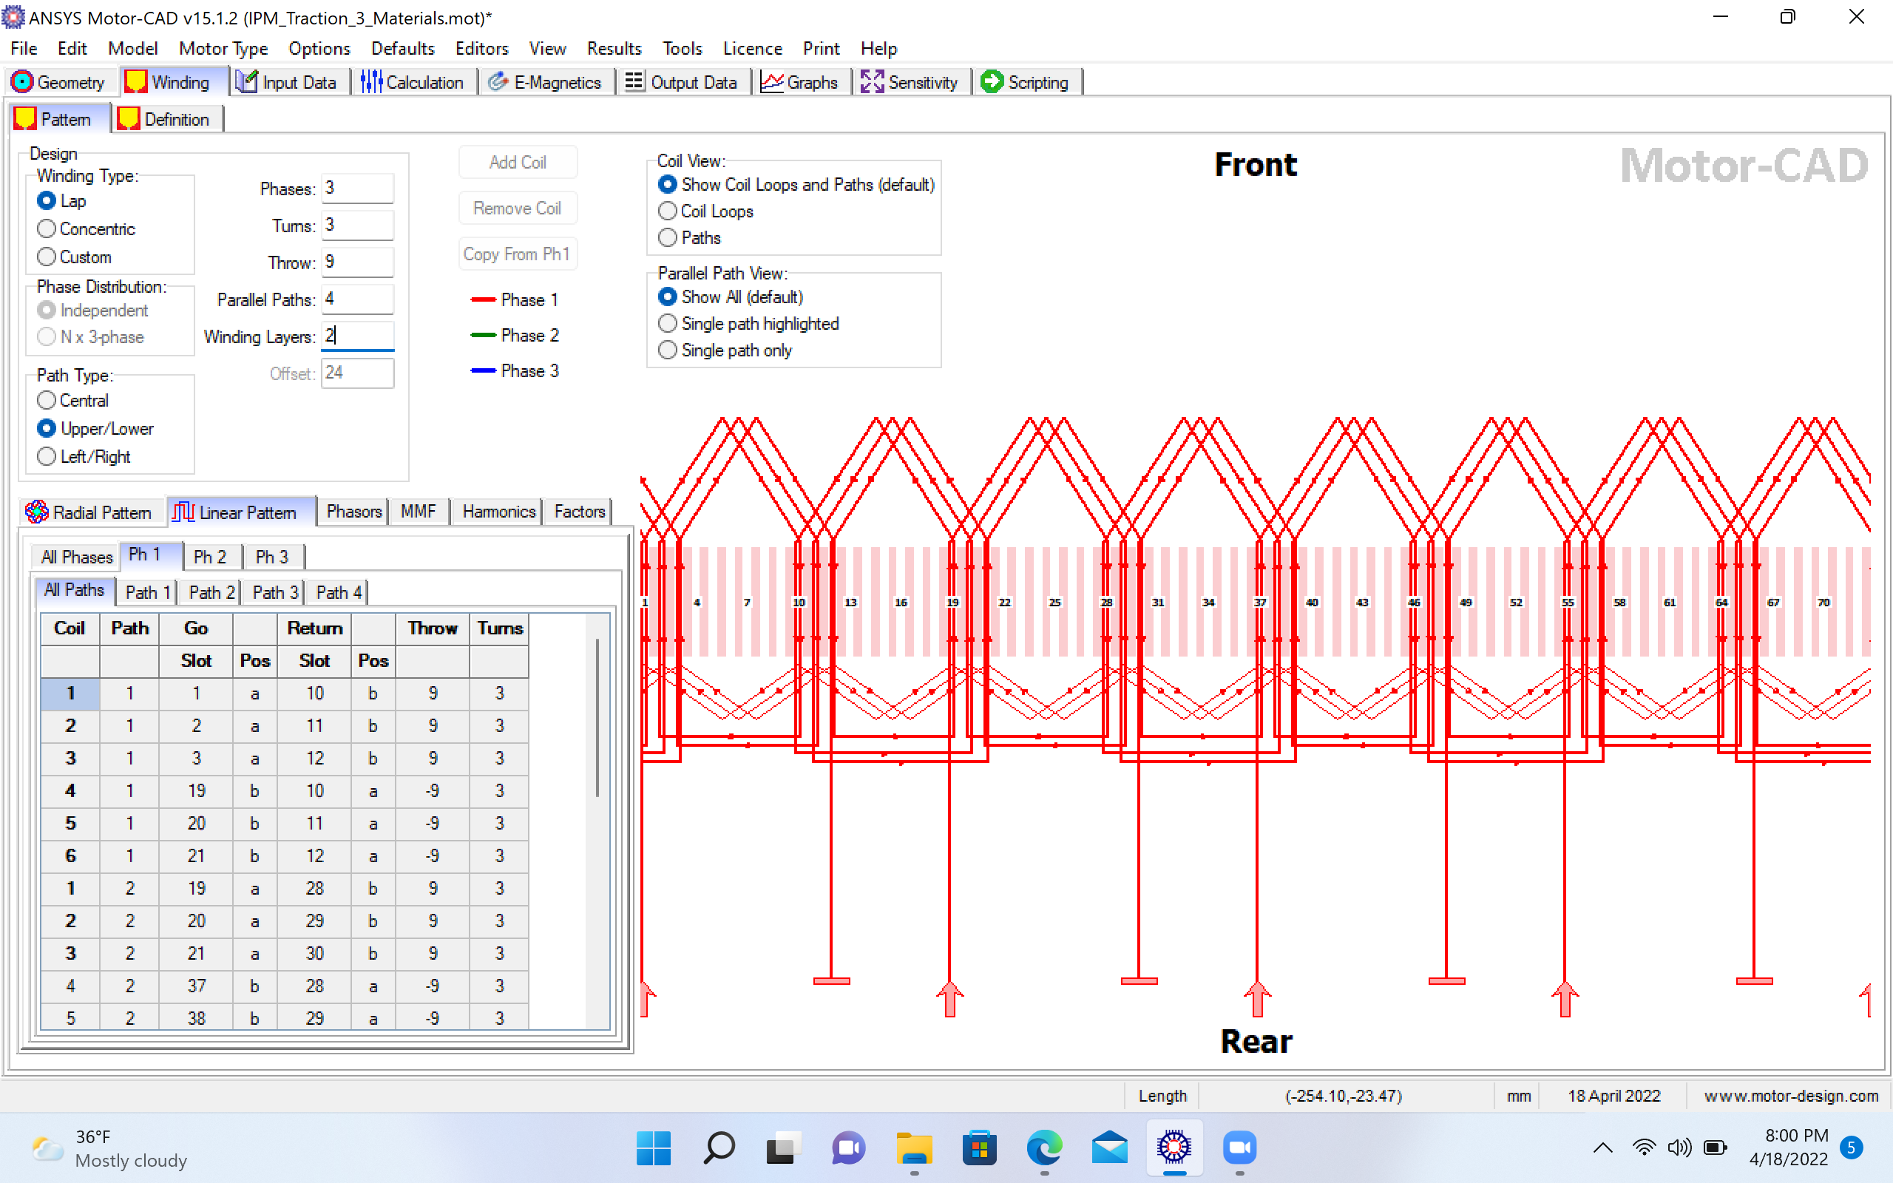
Coil Distribution (Tesla Model S)

Slide 22
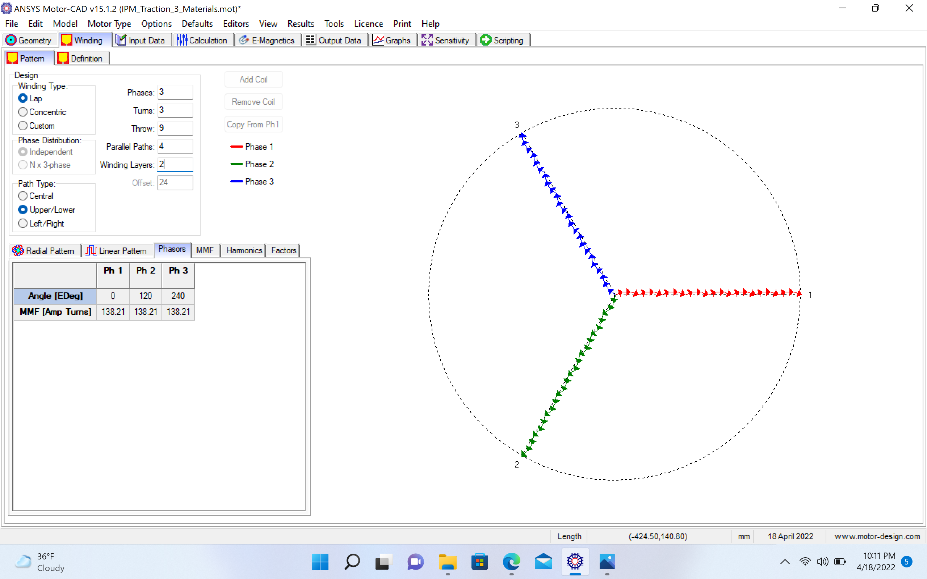
Winding Pattern (Tesla Model S)

Slide 23
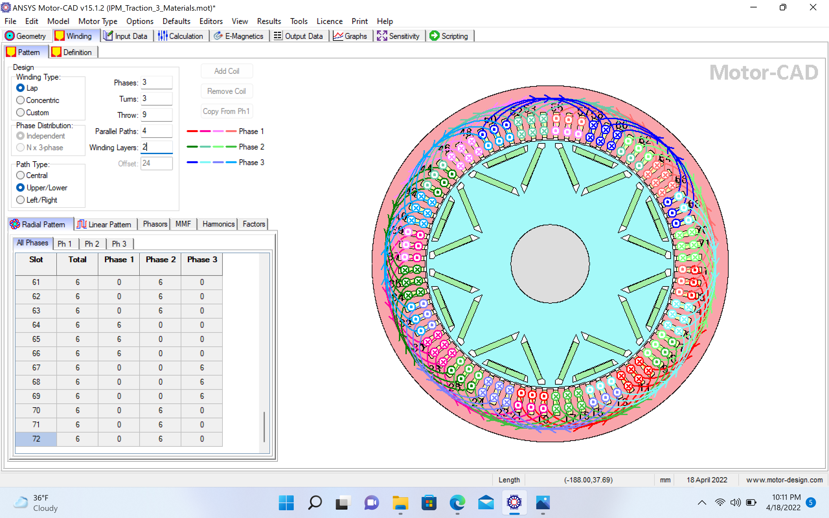
Winding Radial Pattern (Tesla Model S)

Slide 24
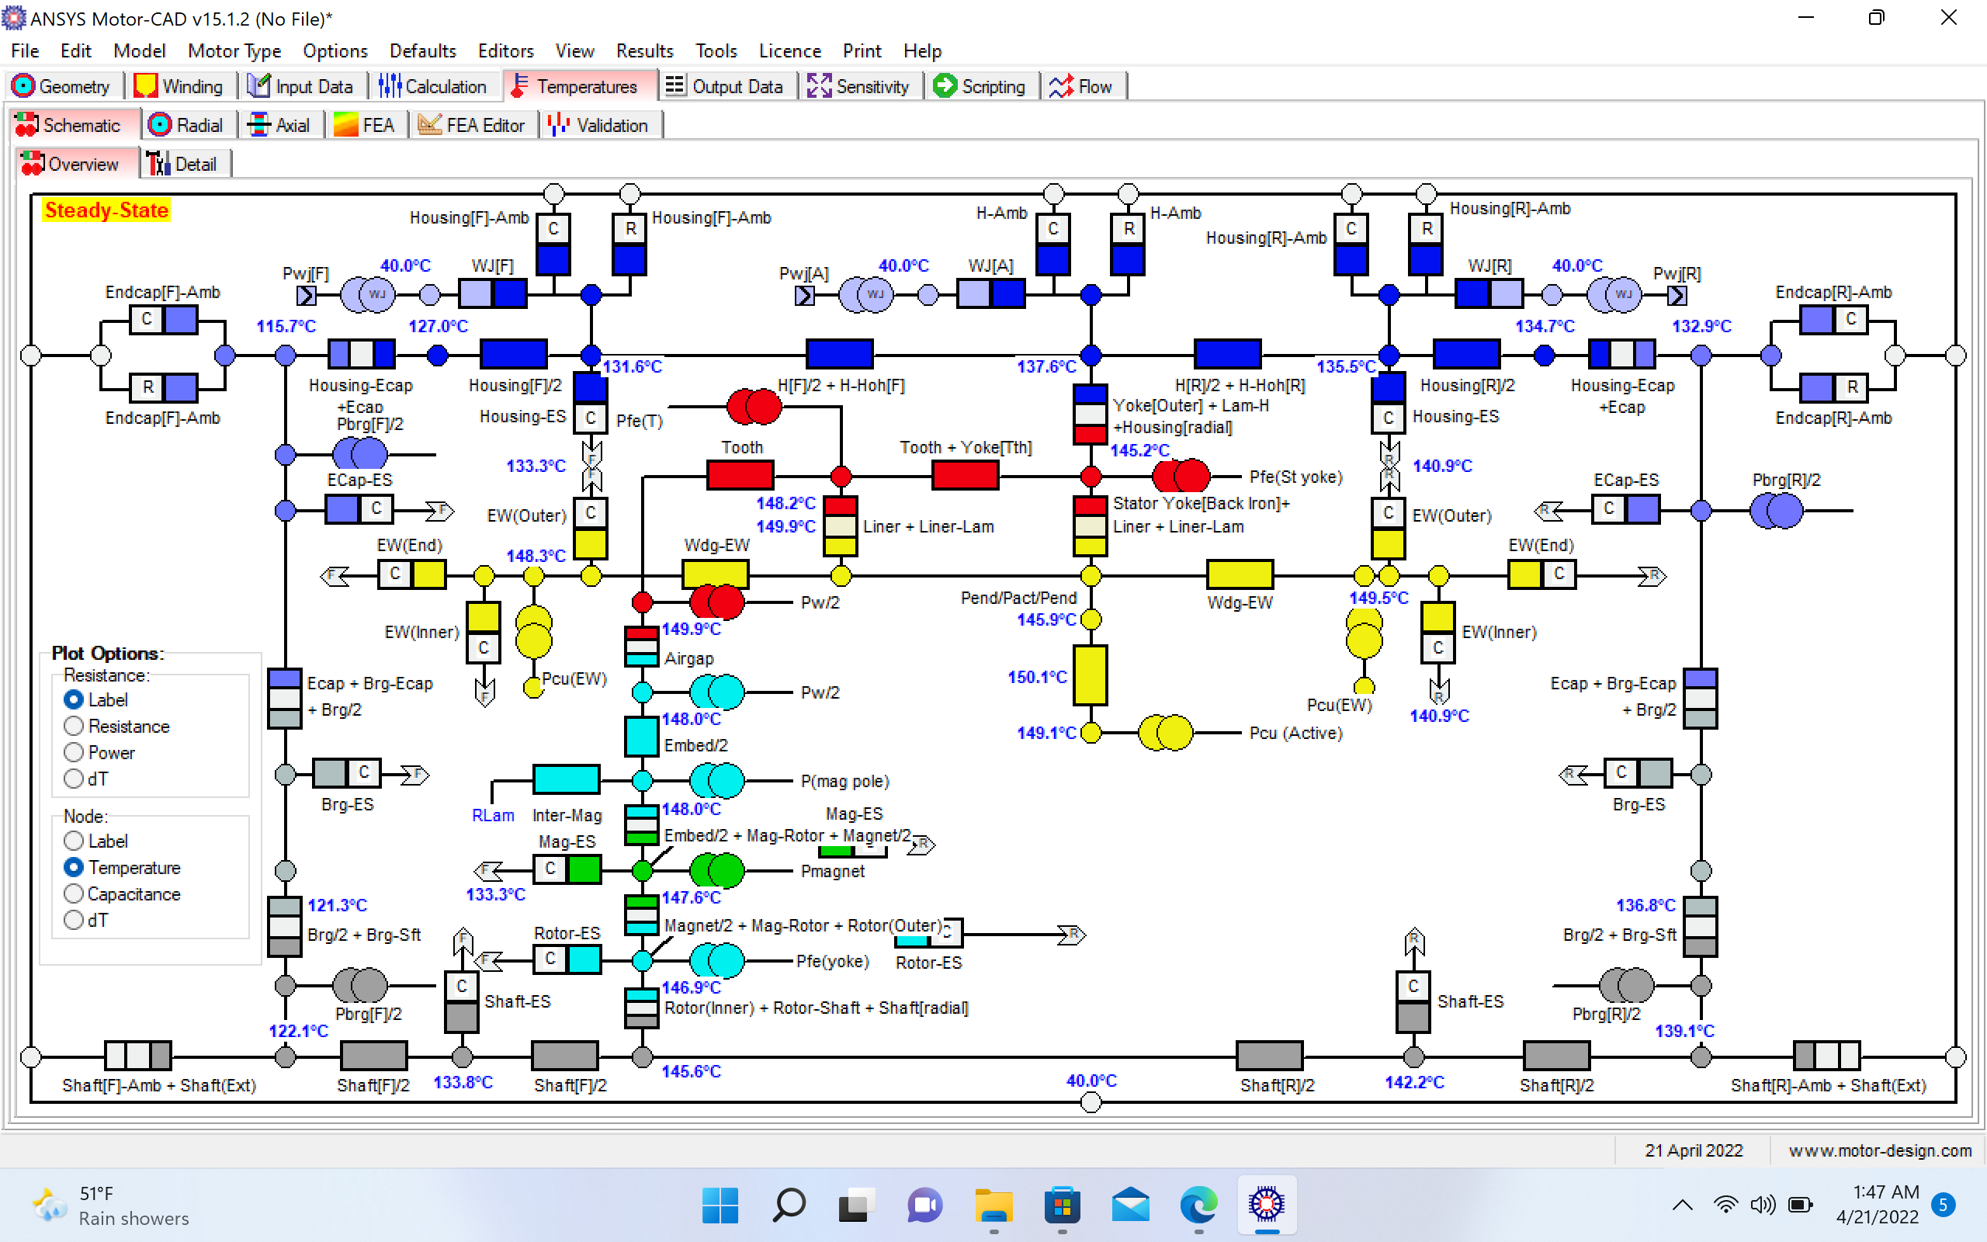
Steady State Behavior (Tesla Model S)

Slide 25
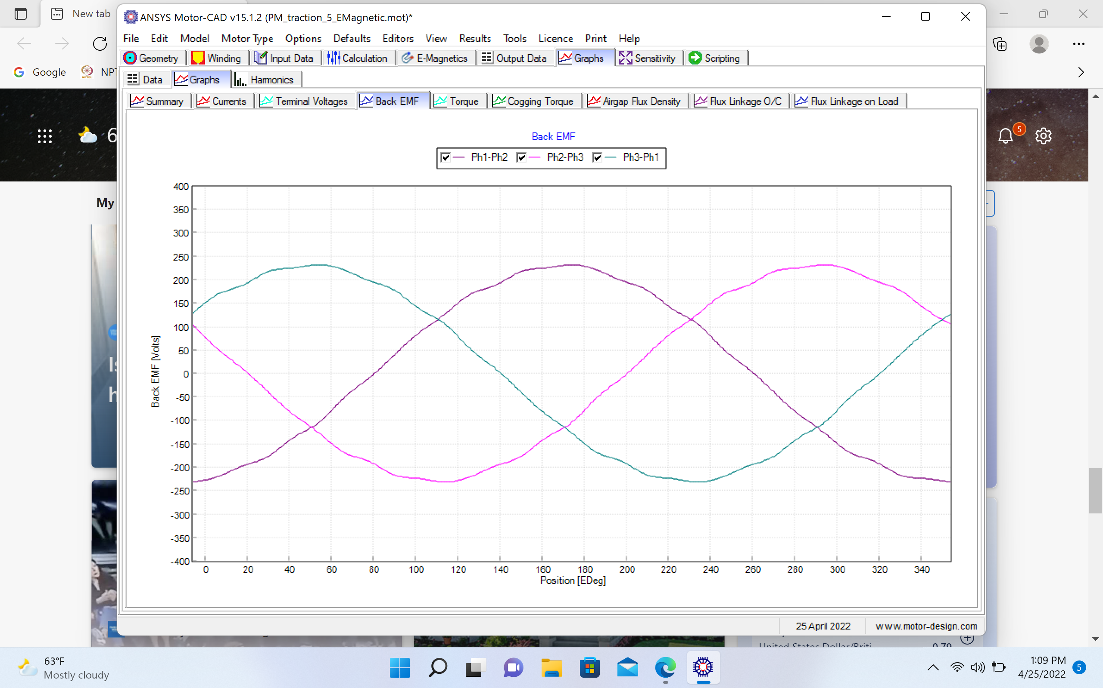
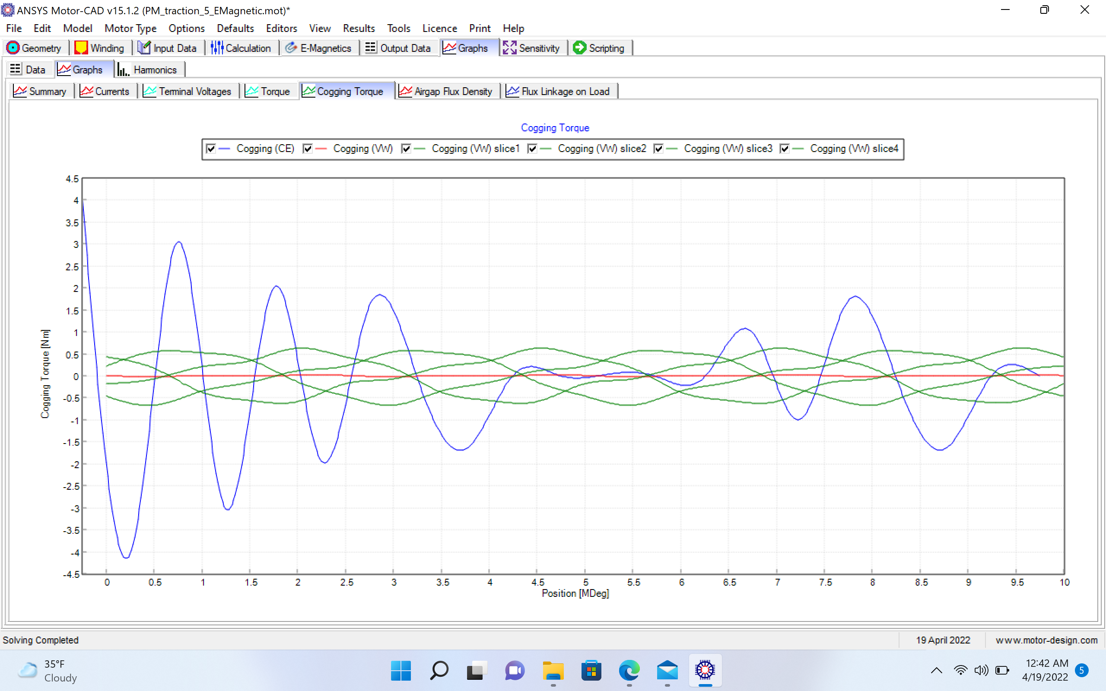
Back EMF & Cogging Torque (Tesla Model S)

Slide 26
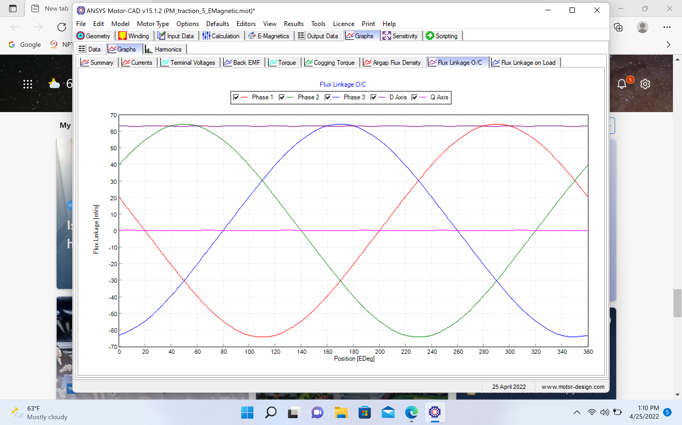
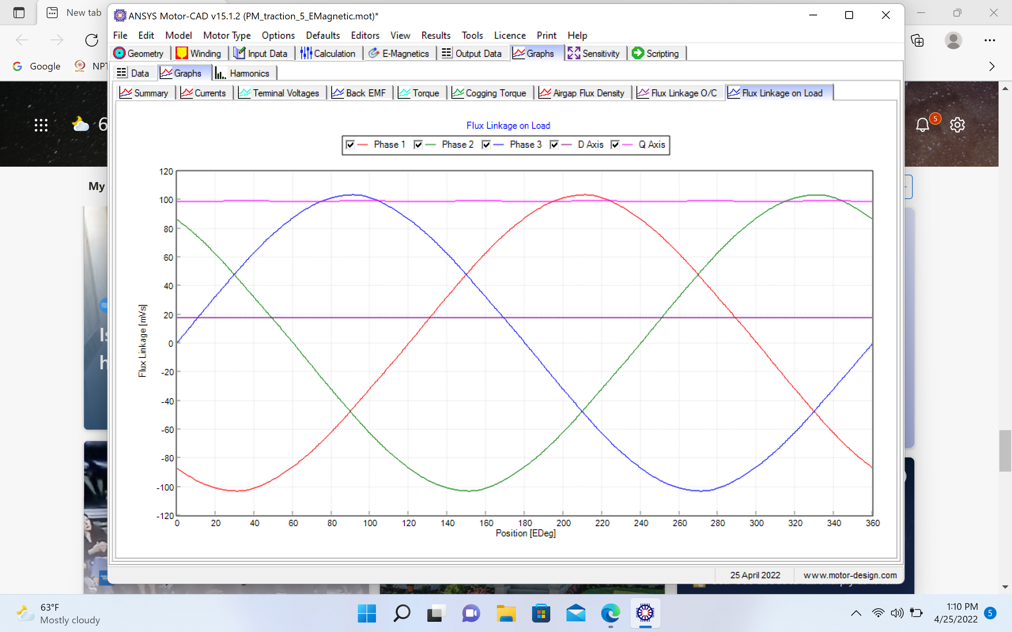
Flux Linkage O/C & Flux Linkage on Load (Tesla Model S)

Slide 27
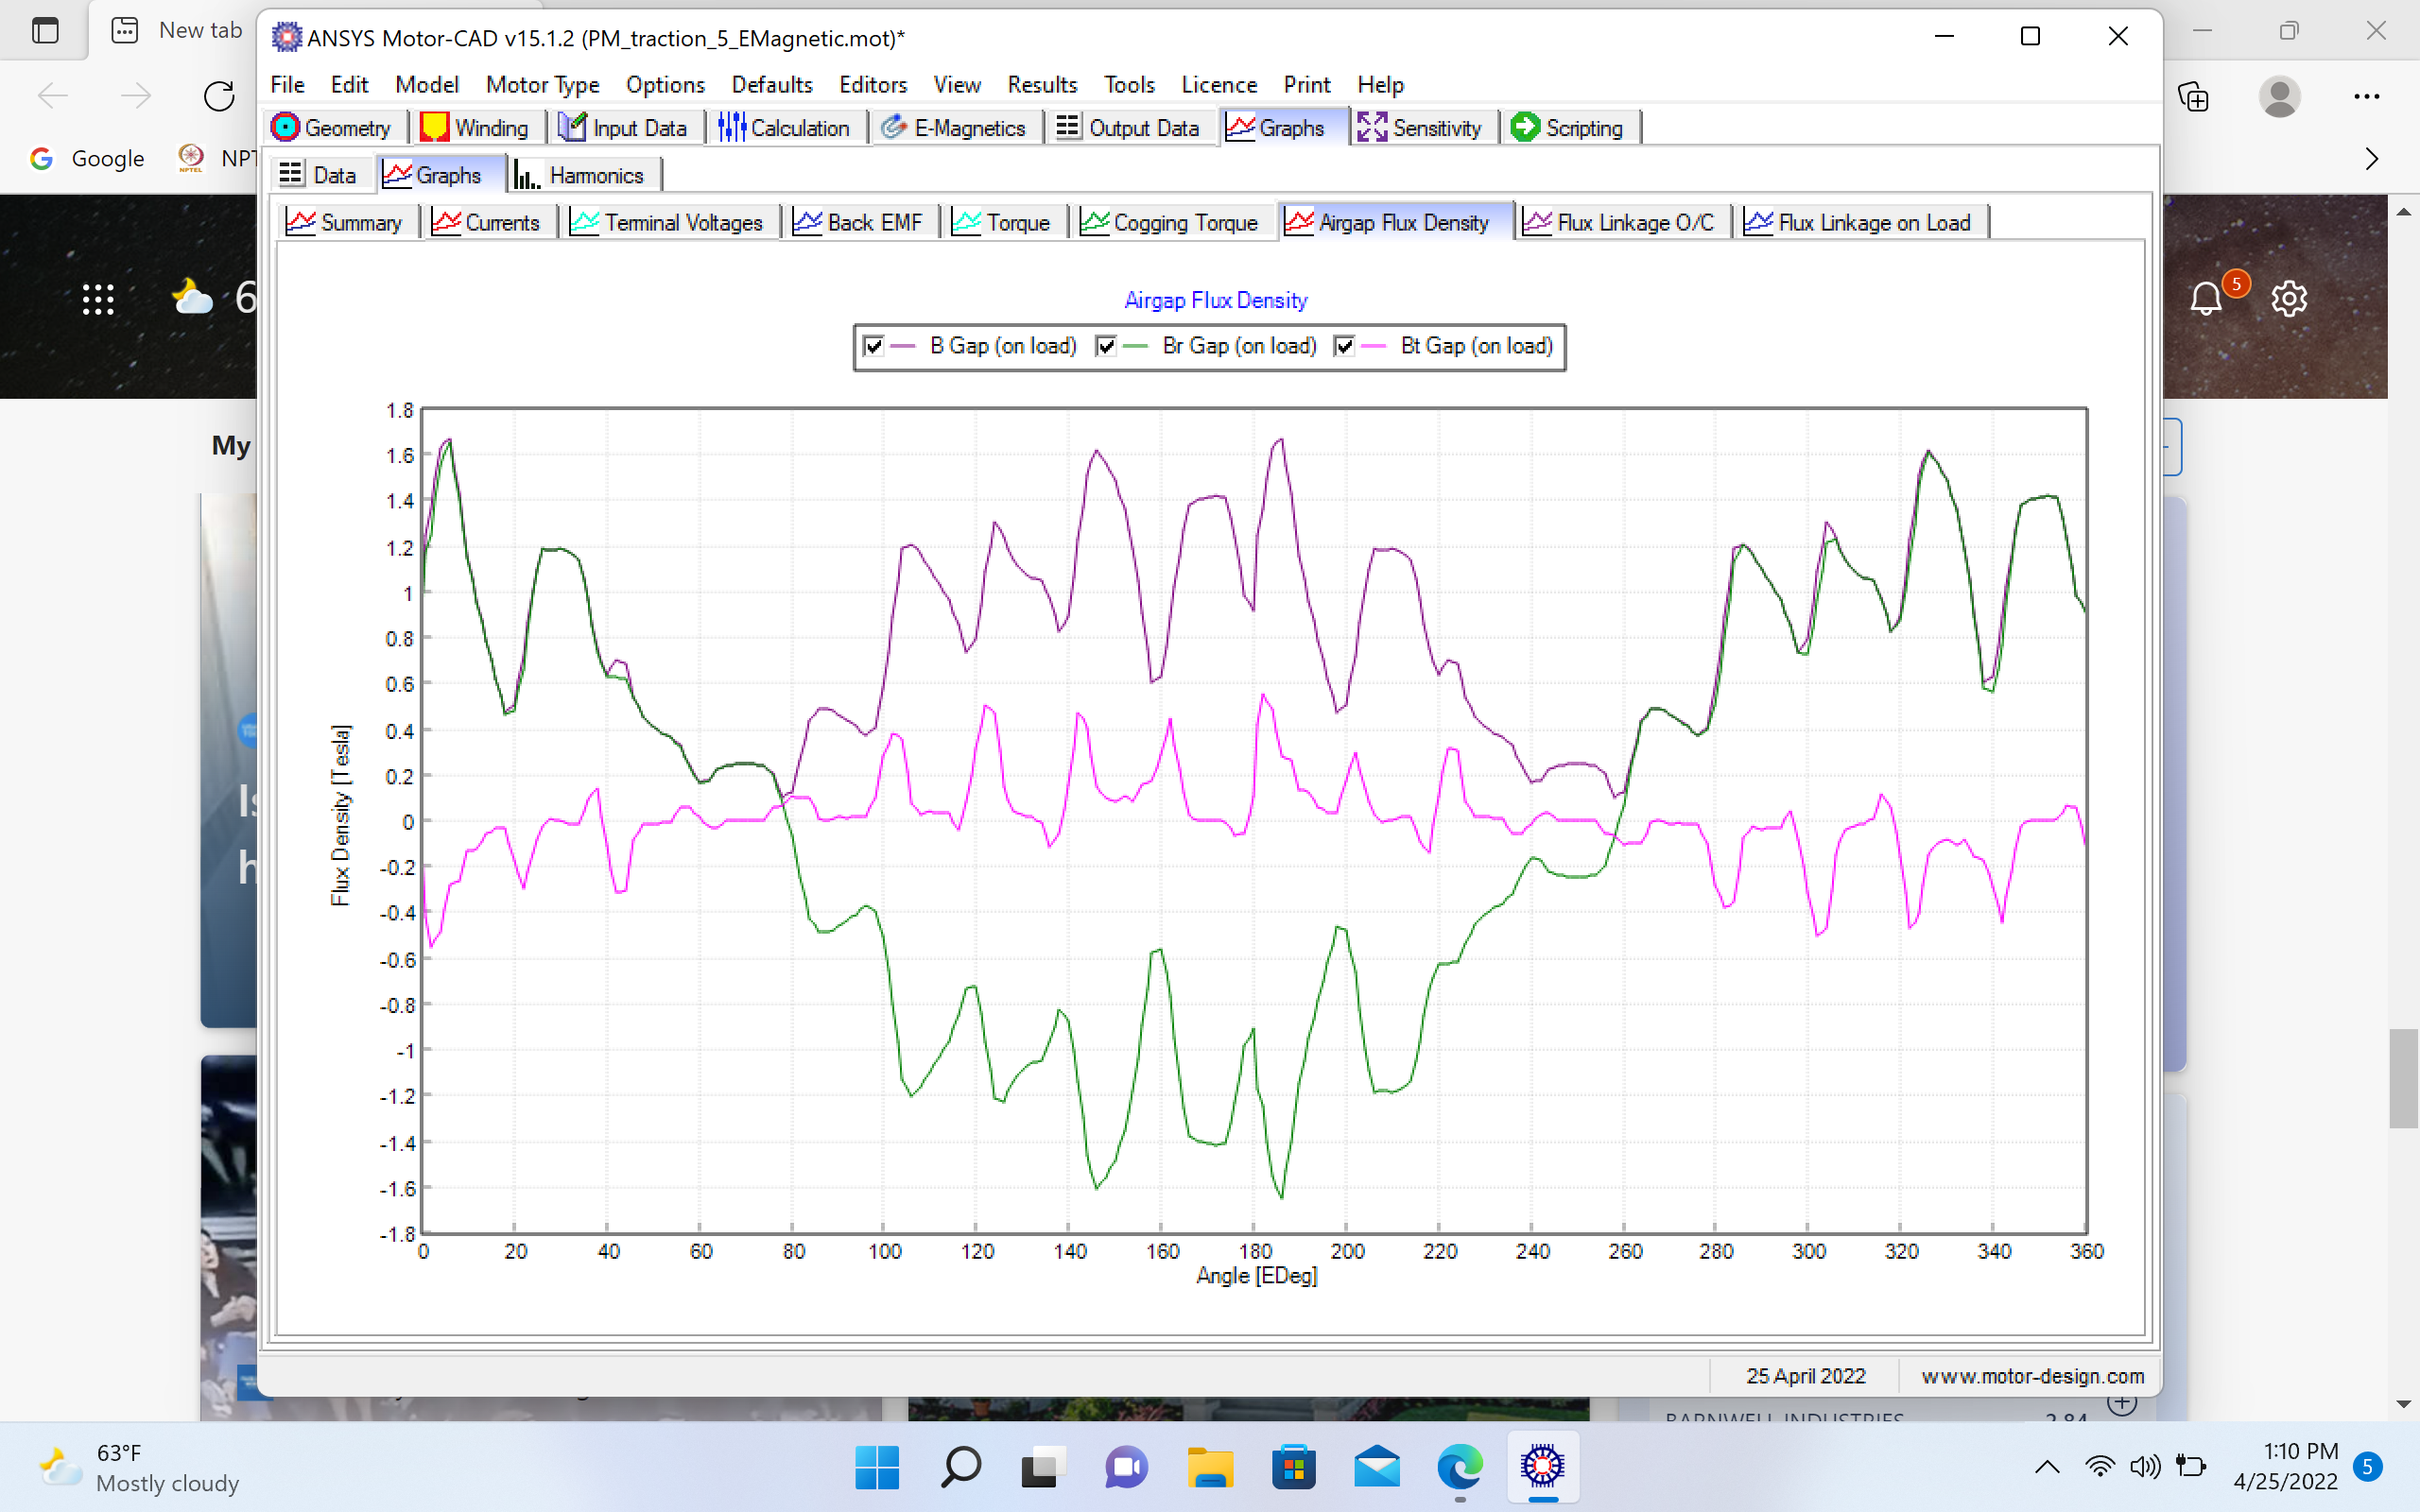
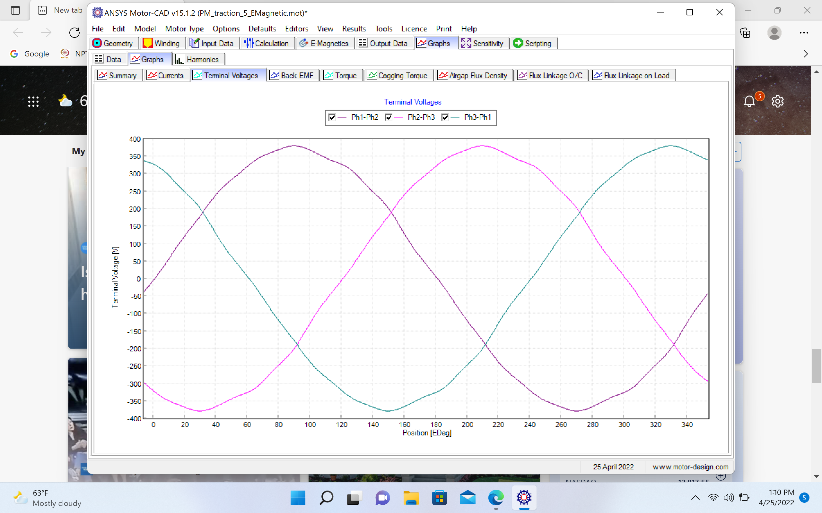
Airgap Flux Density & Terminal Voltage (Tesla Model S)

Slide 28
Conclusion
In this study we compared the two interior permanent magnet motors design and also performed several analysis. The analysis part consist of electromagnetic analysis, thermal analysis, speed-torque analysis, efficiency map and winding analysis. We have also performed the other performance analysis such as cogging torque, back emf, steady state thermal model, air gap flux density graph etc. Design parameter used to perform analysis are not exact to the Tesla S motor and Nissan Leaf motor. There are some parameters approximated due unavailability of data. We have tried to get the similar performance of motors as that of Tesla s and Nissan leaf motor. We have performed some tests on only Tesla Model S because of no data of Nissa Leaf in that particular factor.
We found both IPM motors are accurate or nearly accurate to their value and Motor A is a high power and hifg torque motor whilw Motor B is a high torque and low power motor all performed test results are mentioned in submitted Journal and here.
All tests are performed over “ANSYS Motor CAD”.

Slide 29
References
https://www.energy.gov/sites/prod/files/2014/03/f13/ape051_miller_2013_o.pdf
Nissan Leaf teardown (Part 2): main components disassembled - MarkLines Automotive Industry Portal
https://ijtre.com/wp-content/uploads/2021/10/2020080111.pdf
https://www.cadfem.in/fileadmin/PDF_India/Motor_-_CAD/Introduction_to_Motor-CAD_PDF.
Performance-Analysis-of-Electric-Motor-Technologies-for-an-Electric-Vehicle-Powertrain.pdf
(motor-design.com)
https://www.cadfem.net/fileadmin/user_upload/05-cadfem-informs/cadfem-newsroom/CASCON-FR/Archives/Archive-Form-CADFEM-Ansys-Motor-CAD-2021.pdf
https://www.cadfem.net/fileadmin/user_upload/05-cadfem-informs/cadfem-newsroom/CASCON-FR/Archives/Archive-Form-CADFEM-Ansys-Motor-CAD-2021.pdf).
(PDF) Performance Analysis of Permanent Magnet Motors for Electric Vehicles (EV) Traction Considering Driving Cycles (researchgate.net)
Tesla Model S (Electric Motor Specifications) | PDF | Tesla Model S | Electric Motor (scribd.com)
Nissan Leaf teardown (Part 2): main components disassembled - MarkLines Automotive Industry Portal.
Benchmarking State-of-the-Art Technologies (energy.gov)
(PDF) Modeling and design analysis of the Tesla Model S induction motor (researchgate.net).

Slide 30
THANK YOU

